Slide 1
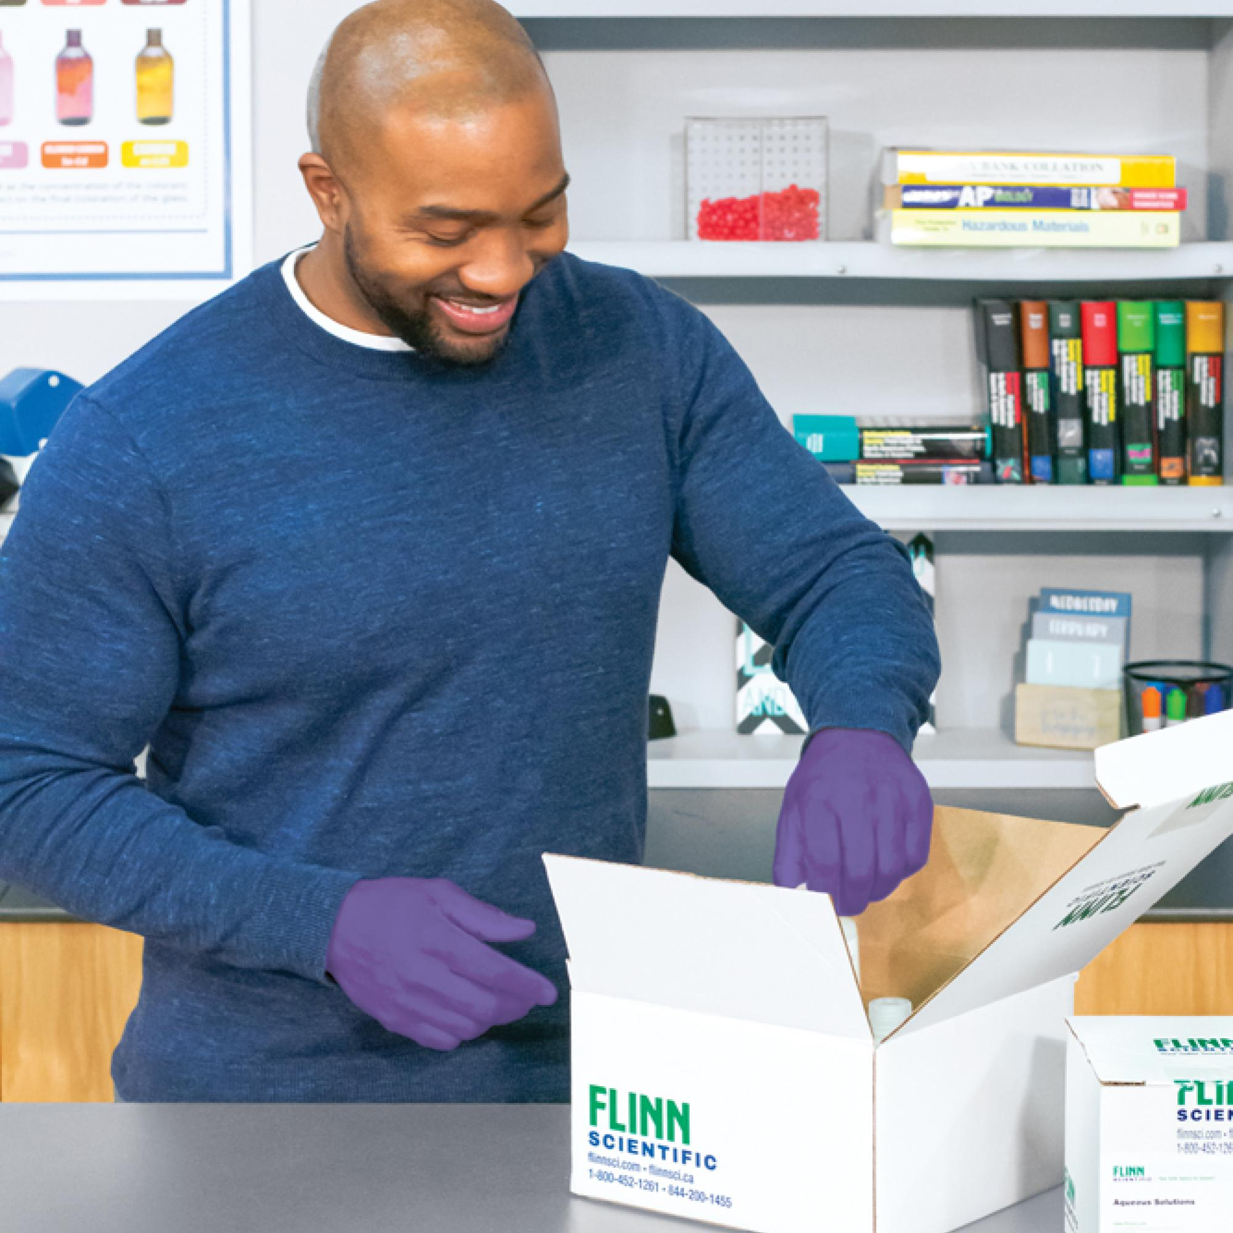
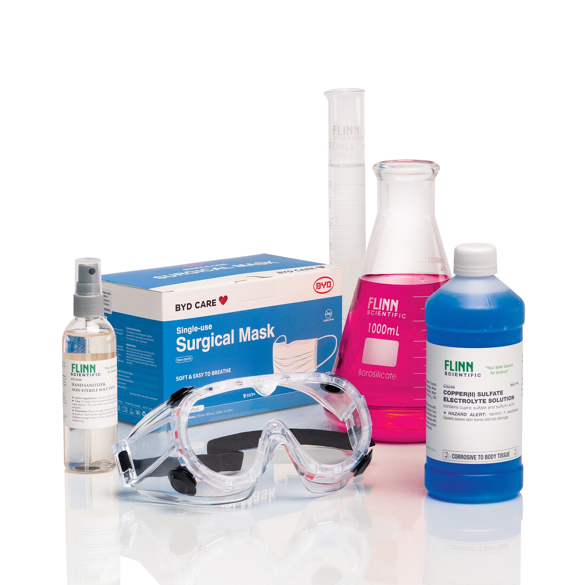
Please find these Resources to Share with your
District Science Leaders and Teachers:
District Proposal
Webinar Invitation
www.flinnsci.com
Secure ESSER Funding for Science and STEM Education
FLINN’s NEW Professional Learning Series and On-Demand Webinars
Science
Safety
Digital Catalog
Continuation of Safety & NEW COVID-19 Science Classroom Safety Document
FLINN’s Science Catalog Reference Manual Digital Copy
Learn More! Contact Tom Trapp: 402-960-5578 | ttrapp@flinnsci.com

