Slide 1
Flinn Hands-on Integrated Science Activities for Middle School Presented by Janet Hoekenga (Staff Scientist/Middle School Specialist)
Welcome!

Slide 2

Today’s Workshop
•Hands-on Experiment
Mystery Solutions Match-up
•Demonstrations
Earthquakes and Resonance
Out of the Corner of Your Eye
Mystery Light Block

Slide 3
Mystery Solutions Science Practices
Planning & carrying out investigations
Analyzing & interpreting data
Constructing explanations
Engaging in argument from evidence
Obtaining, evaluating, & communicating information

Slide 4
Sample Procedure
Wear goggles!
Two people share bottles A, B, C.
Their partners use bottles 1, 2, 3.
Brainstorm how to solve problem.

Slide 5

Sample Procedure, cont.
Test solutions. Remember: No peeking at your partner’s work area!
Caution: Avoid contamination!
Record results.
Draw conclusions.

Slide 6
Sample Results Table
Solutions | Results | Solutions | Results
A + B |  | 1 + 2
A + C |  | 1 + 3
B + C |  | 2 + 3

Slide 7
Mystery Solutions – Conclusions
Solution B and solution ___ were both involved in producing bubbles and a cloudy white precipitate; therefore
B =__.
C was other solution that produced bubbles, as was solution ___; so
C = __.
By process of elimination,
A = __.

Slide 8
Mystery Solutions Match-up Explanation
The Mystery Solutions are
A and 2 = aluminum potassium sulfate (alum)
B and 3 = sodium bicarbonate (baking soda)
C and 1 = citric acid

Slide 9
Mystery Solutions Match-up Chemical Reactions
Citric acid + sodium bicarbonate → sodium citrate + carbonic acid
The carbonic acid decomposes into water and carbon dioxide.
The carbon dioxide forms the bubbles that students observe.
None of the products of the citric acid and alum reaction are insoluble in water; therefore no change is observed.

Slide 10
Mystery Solutions Match-up Chemical Reactions
When dissolved in water, sodium bicarbonate forms a slightly basic solution with OH⁻(aq) anions.
Alum (aluminum potassium sulfate), when dissolved in water, forms the cations Al ³⁺(aq) and K⁺(aq) in solution, along with the sulfate anion, SO₄²⁻(aq).
When alum and baking soda solutions combine, a white precipitate of aluminum hydroxide is formed.
Al³⁺(aq) + 3OH⁻(aq) → Al(OH)₃(s)

Slide 11
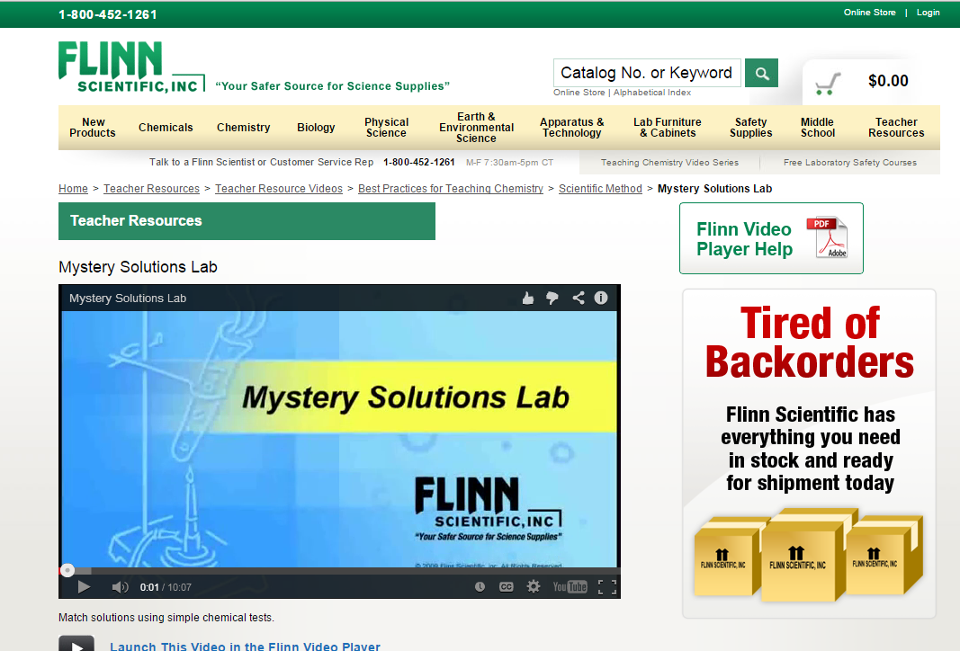
Mystery Solutions Match-up Resources
You can watch a video of this lab at
http://www.flinnsci.com/teacher-resources/teacher-resource-videos/best-practices-for-teaching-chemistry/scientific-method/

Slide 12
Mystery Solutions – Disposal
Wipe up solutions in aluminum dish with paper towel.
Place bottles back in kit box.
Place Visor goggles back in box.
Thank you!

