Slide 1
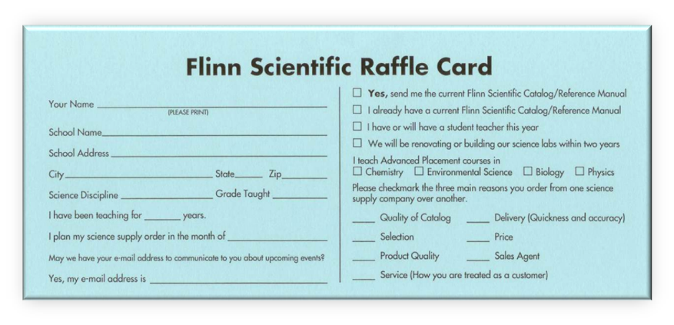
Flinn Favorite Biology Lab Activities and Games
Presented by:
Matt Anderson
Please fill out your blue raffle card and pass to a Flinn representative!

Slide 2
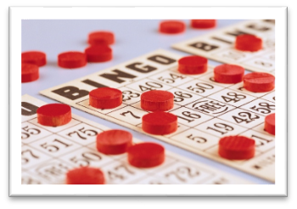
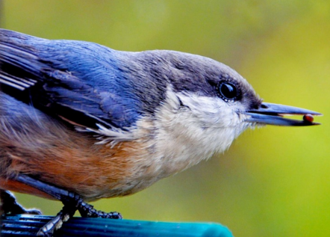
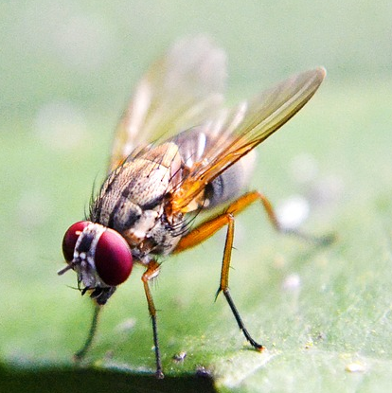
Today’s Activities
Demonstrations
Upset Tummy? MOM to the Rescue!
Beaks – Flinn STEM Design Challenge™
Hands-On Games
Take As Directed
Codon Bingo
Simulation
Drosophila Genetics

Slide 3
Help from MOM
Biochemistry of Antacids
Demonstration teaches
Acids and bases
Buffers
Digestion
Antacid testing
Consumer biochemistry
Milk of Magnesia (MOM)
weak base
neutralizes stomach acid
relieves heartburn, upset stomach and indigestion
Notes:
WEAK BASE: Active ingredient – magnesium hydroxide which forms a suspension in water due to low solubility
NEUTRALIZES: Ideal because it doesn’t dissolve at once…dissolves slowly as it reacts with and neutralizes stomach acid
HEARTBURN: caused when stomach acids irritate and partially digest esophageal lining

Slide 4
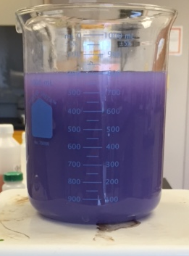
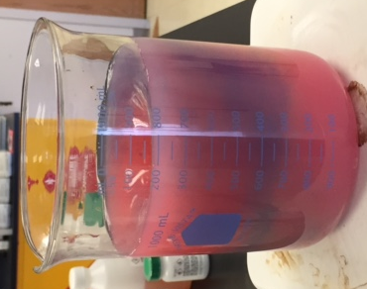
Help from MOM
Mg(OH)₂
Weak base - limited solubility in water
Universal indicator
See pH changes
Mg(OH)₂ solution
Purple (basic) pH ≥ 10
Add HCl
Simulated stomach acid
Turns red pH ~ 4
MOM dissolves, reacts with acid
Notes:
Stomach acid pH <2 with empty stomach
Rainbow of colors:
Acid disperses through the beaker and is neutralized by MgOH causes purple to red color change. Unreacted acid will cause more MgOH to be pulled from solution until all acid is gone then return to purple (pH 10) indicating excess MgOH present. Continue to add HCl until all MgOH is reacted (beaker contents stay red)

Slide 5
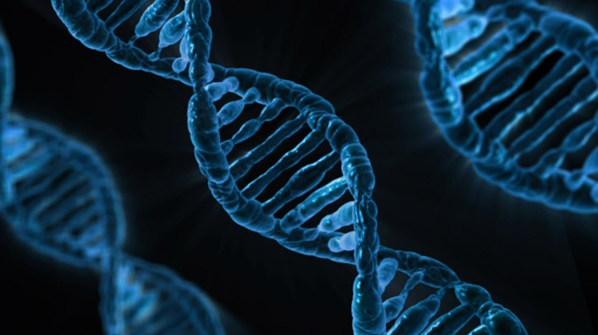
Drosophila Genetics Simulation
Why Drosophila?
Model organisms
Mendelian inheritance
Genome
Morphology
Notes:
Model Organism – complex multicellular organism with patterns similar to humans, ex: 60% of genes that cause human disease have a recognizable match in the fruit fly genome
Mendelian Inheritance – easy to perform crosses that result in expected genotypic and phenotypic ratios
Genome – sequenced in 2000, four pairs of chromosomes (1 sex, 3 autosomes)
Morphology - physical structures students study are easily identified once flies are anesthetized

Slide 6
Drosophila Genetics Simulation
Positive
Small size
Inexpensive
Simple habitat
Short life cycle
High reproductive rate
Short generation time
Negative
Culturing time
Pests
Live Drosophila
Notes:
ADD IMAGE - find image of vials with flies
GOODs:
Small size. They don’t take up lab space.
Inexpensive.
Simple habitat. Vial, foam plug net
One generation 10-20 days @ 21-25 °C
One female lays ~500 eggs in 10 days
Egg to adult fly = 14 days (8 days as egg and larval stages (3) and 6 days a pupal stage). Within 8-12 hours newly emerged flies are capable of mating, adults can survive for several weeks
BADs
Time- massive time constraints - the flies don’t sleep for nights, weekends, spring break. No matter what else is going on in your life you have to check them every 8-12 hours to ensure accurate results.
Pests if they escape…

Slide 7
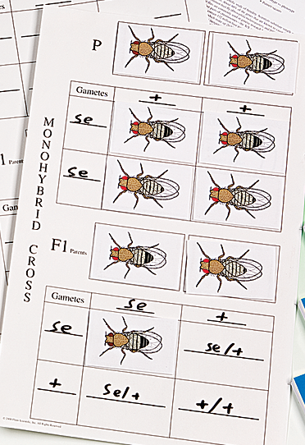
Drosophila Genetics Simulation
Why Simulation?
Study genetic crosses
Several mutants present
No time constraints
No flies
Includes card deck and cross sheet
Notes:
Mutants available include:
Eye colors – sepia, white, (red = wildtype)
Body colors – ebony (brown =wildtype)
Wing types – dumpy (regular = wildtype)

Slide 8
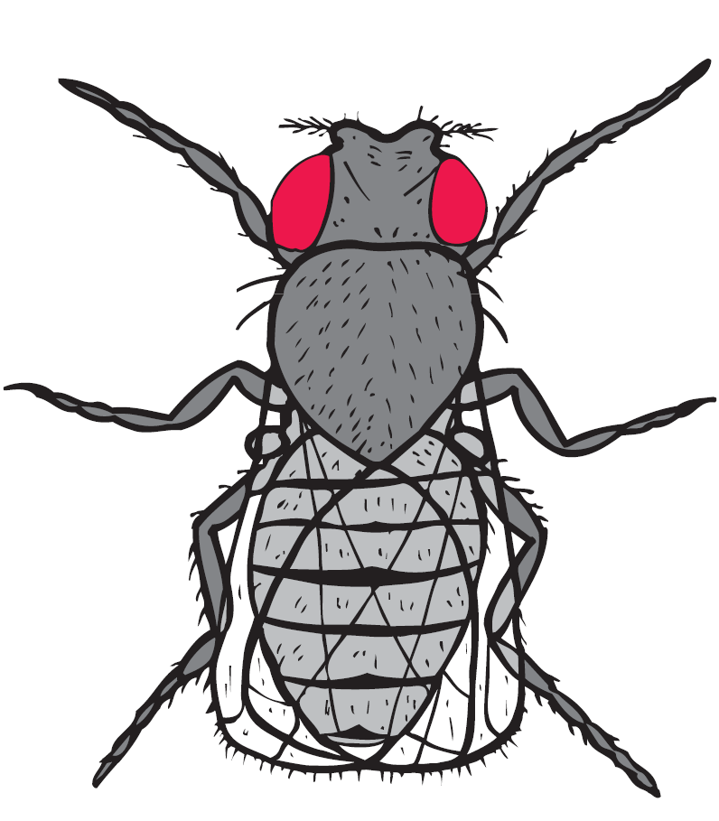
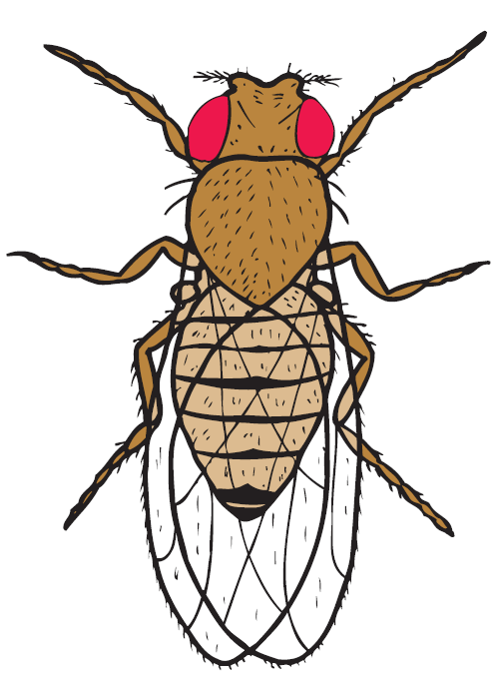
Drosophila Genetics Simulation
Drosophila traits
Male vs female
Wild-type vs. mutant
Typical mutations include change in eyes, wings, antennae, etc.
Notes:
Male vs female
*male has sex comb on forelegs (both) absent in females
*male has large, thick band at end of abdomen
*female has striped banding at end of abdomen
Wild-type
*typical appearance (yellow-brown body, red eyes, round eyes, full wings)
Mutant
*genetic variation (naturally occurring or artificially induced)

Slide 9
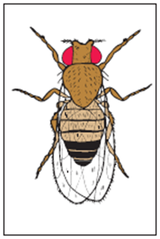
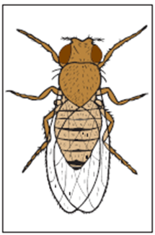
Drosophila Genetics Simulation
Question: What is the inheritance pattern for red and sepia eye color?
True breeding, red-eyed male
True breeding, sepia-eyed female
Notes:
First monohybrid cross – wildtype (red eyes) with mutant sepia eyes

Slide 10
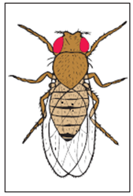
Drosophila Genetics Simulation
P cross: Two true-breeding parents with the traits you are testing.
X
Notes:
All offspring show wildtype eye (red)

Slide 11
Drosophila Genetics Simulation
Why? Is sepia gone forever? How can we further test?
X
Notes:
All offspring show wildtype eye (red)

Slide 12
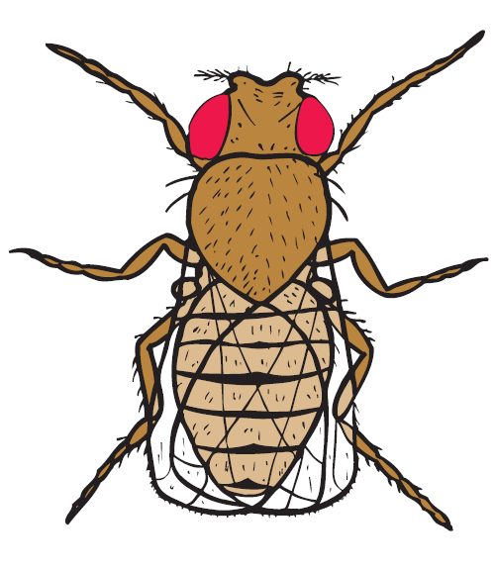
Drosophila Genetics Simulation
Cross two F1 flies
Notes:
Show red eyes but carry recessive allele for sepia eyes

Slide 13
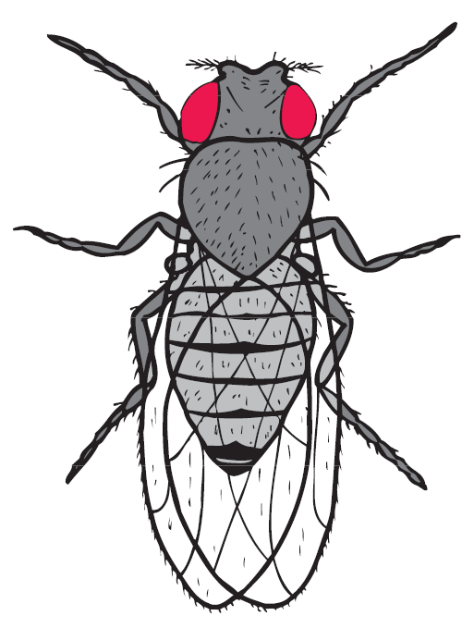
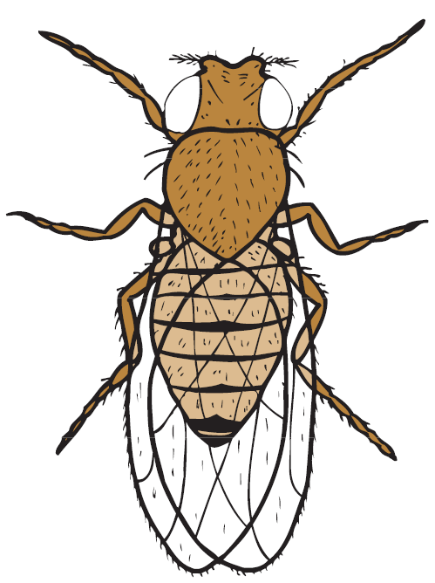
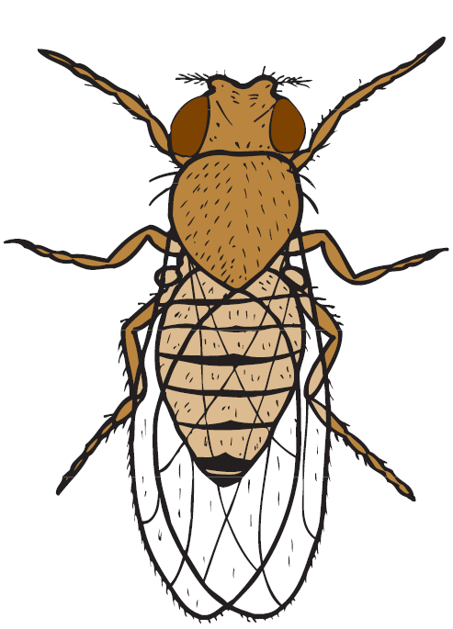
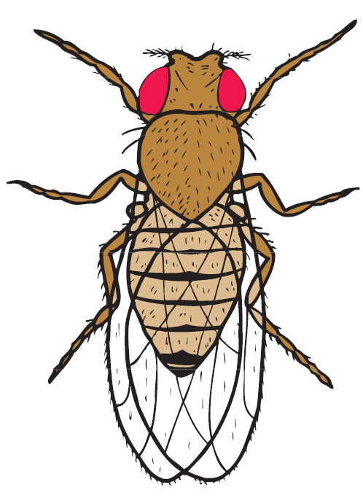
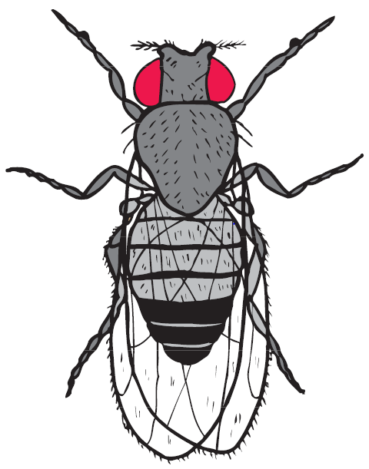
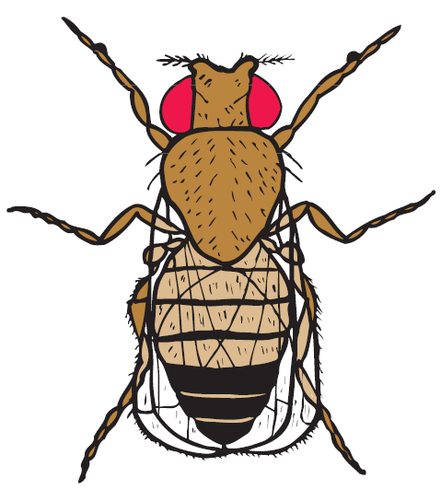
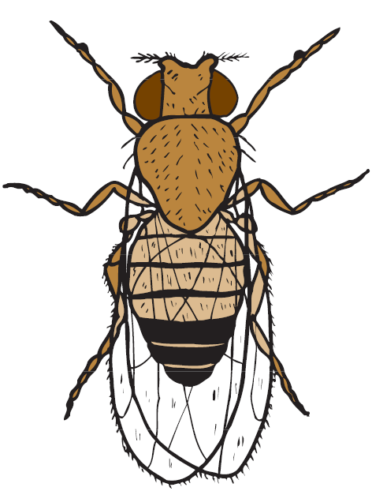
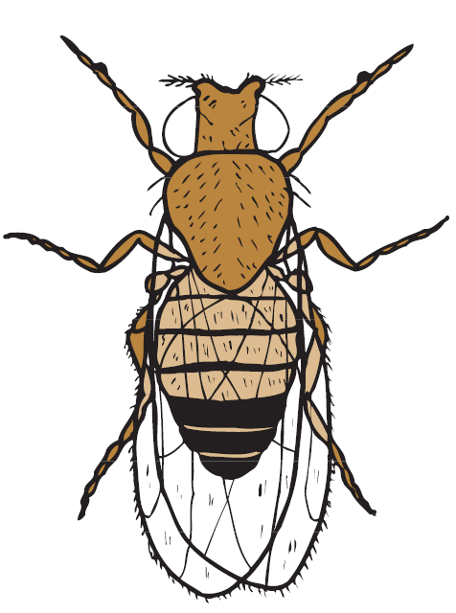
Drosophila Genetics Simulation
Options
Notes:
The kit allows for dihybrid crosses, backcrosses and sex linked crosses
Females (top – no band, larger)
Males (bottom – banded, smaller)
Backcross – crossing a hybrid with one of its parents/individual genetically similar to achieve genetic identity closer to that of the parent.

Slide 14
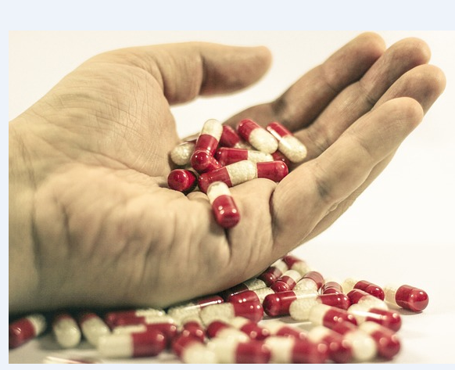
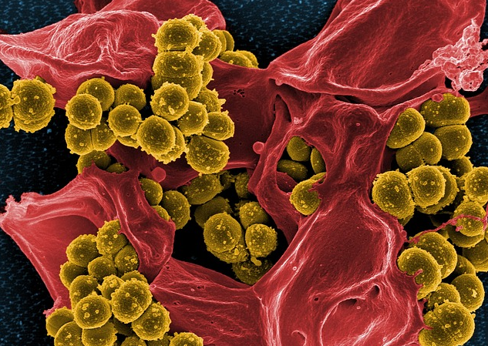
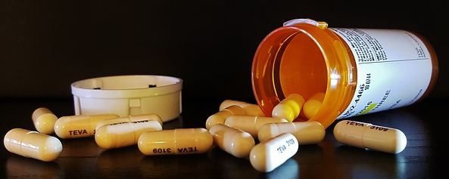
Hands On Activity
Antibiotics can reduce the severity and duration of infections, but only when taken as directed!
Signs of Bacterial Infection – sore throat, cut that won’t heal
Take As Directed
Antibiotic Resistance Simulation
Activity:
Simulation of a patient with bacterial infection being treated with antibiotics
“Take all medication as directed until finished, unless otherwise directed by a doctor.”

Slide 15
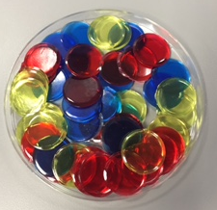
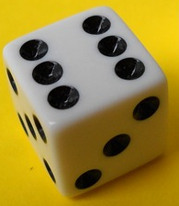
Take As Directed Antibiotic Resistance Simulation
Materials
Bingo chips (represent bacteria)
Red, 25 (least resistant)
Blue, 20 (moderately resistant)
Yellow, 15 (extremely resistant)
Die (six-sided)
Notes:
This activity uses bingo chips to simulate what happens when a person sick with a bacterial infection is treated using antibiotics.

Slide 16
Take As Directed Antibiotic Resistance Simulation
Set out bingo chips
13 red
6 blue
1 yellow
Procedure
Notes:
Bingo chips represent HARMFUL bacteria found in that patient’s body PRIOR to treatment
Rolling the die represents the dose of antibiotics taken.

Slide 17
Take As Directed Antibiotic Resistance Simulation
Procedure
Antibiotic Rules
Example – student rolls a 3
Number Rolled | Event | Result
2, 3, 4 or 5 | Antibiotic taken at appropriate time *bacteria killed | Remove 5 bingo chips total *red, then blue and lastly yellow
1 or 6 | Antibiotic NOT taken at the appropriate time *bacteria NOT killed | Do not remove any bingo chips

Slide 18
Take As Directed Antibiotic Resistance Simulation
Procedure
Start
13 red
6 blue
1 yellow
Roll 3
Remove 5 red
Don’t roll again…yet

Slide 19
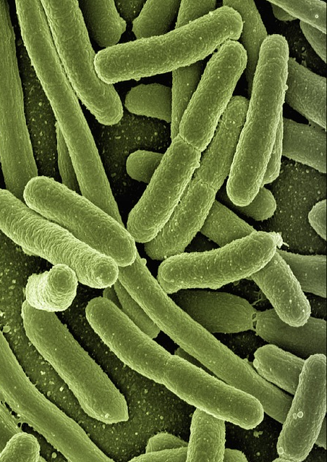
Take As Directed Antibiotic Resistance Simulation
Procedure
Bacteria are always reproducing!
Add one bingo chip of each color IF there are bingo chips remaining
Notes:
If one or more bacteria of a particular type (color) are still present after antibiotic dose, add one chip of that color to the population.

Slide 20
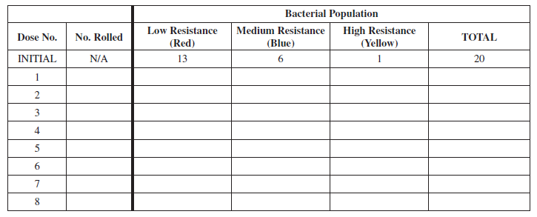
Take As Directed Antibiotic Resistance Simulation
Procedure
Record remaining bacteria/bingo chips in data table
3
9
7
2
18
Notes:
Roll dice again and continue until “8 days of antibiotics have been taken.”
Fill data table

Slide 21
Take As Directed Antibiotic Resistance Simulation
Antibiotic Rules
Number Rolled | Event | Result
2, 3, 4, or 5 | Antibiotic taken at appropriate time *bacteria killed | Remove 5 bingo chips total *red, then blue, then yellow
1 or 6 | Antibiotic NOT taken at appropriate time *bacteria NOT killed | Do not remove any bingo chips
Procedure
1. Roll
2. Reproduce
3. Record
4. Repeat

Slide 22
Take As Directed Antibiotic Resistance Simulation
Results
Notes:
One example of results, however trend of red bingo chips getting knocked out quickly while blue chips increase before being knocked out and yellow chips continue to gain in number and will be eliminated “with correct duration.”

Slide 23
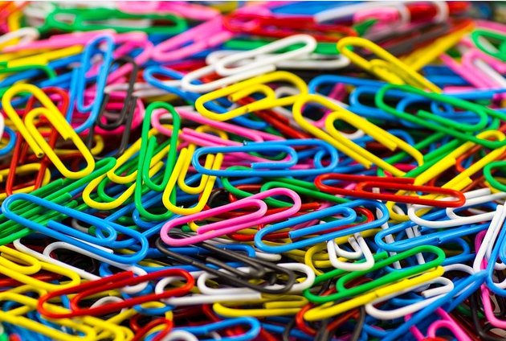
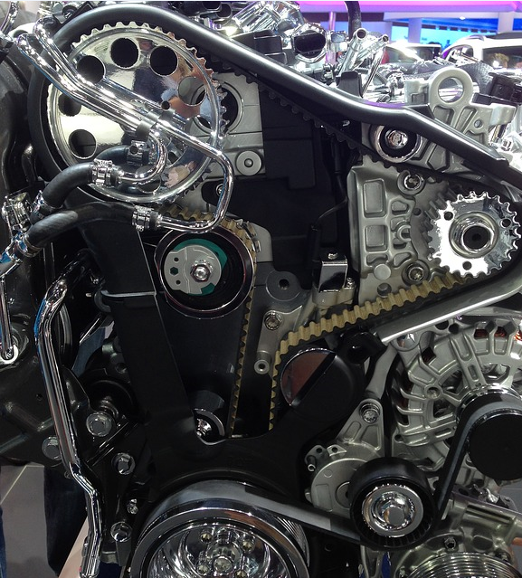
Beaks – Flinn STEM Design Challenge
Engineering – a systematic and iterative approach to designing objects, processes and systems to meet human needs and wants
Technology – any modification of the natural world made to fulfill human needs or desires
Application of science – any use of scientific knowledge for a specific purpose
*from A Framework for K-12 Science Education, National Research Council
Notes:
From the definitions, it is clear that technology is not just computers and smart boards.
*A paperclip was engineered to hold papers together, fulfilling a human need, simple as it may be.
Many activities:
*already STEM-oriented
Other activities:
*slight modifications
*provide the opportunity for inquiry and design
*help students connection science and engineering

Slide 24
Beaks – Flinn STEM Design Challenge
STEM
Engineering Design Process
Define Problem
Reflect & Redesign
Research / Generate Ideas
Test & Evaluate
Select a Solution
Build Design (Prototype)
Notes:
*Many different, cyclical diagrams that demonstrate the engineering design process
*Two big components are building a unique prototype and that there are multiple possible solutions

Slide 25
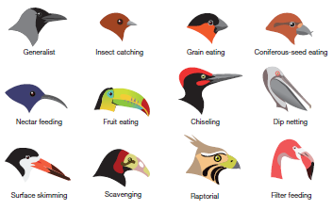
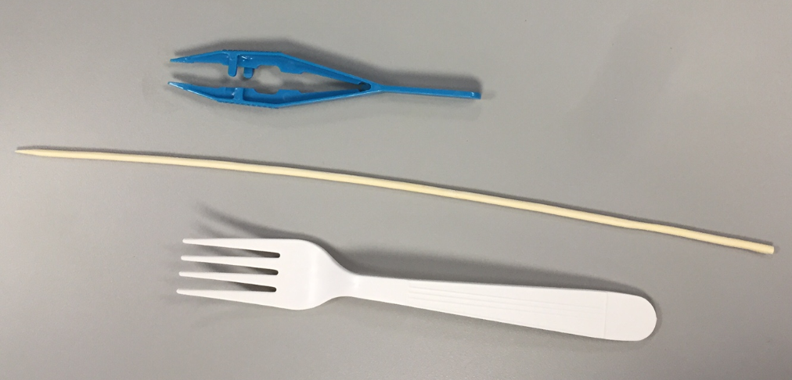
Beaks – Flinn STEM Design Challenge
Activity
Overarching Purpose
Experience natural selection through a STEM approach
Baseline activity introduces:
Scientific Concepts – natural selection, survival of the fittest, and more
Problem – type of beak that successfully withstand environmental changes
Possible solution – three simple beaks
Design Challenge has students take what has been learned from the baseline activity, with added criteria and constraints, and design a unique solution
Notes:
Concepts: microevolution, alleles

Slide 26
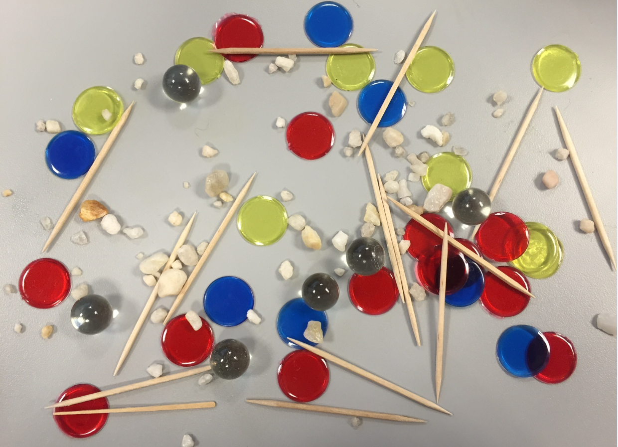
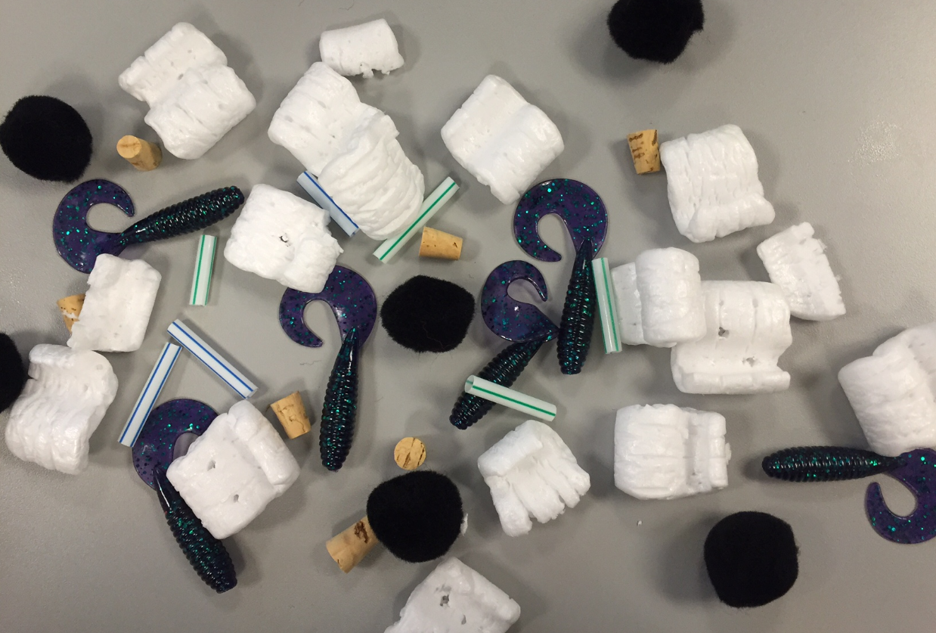
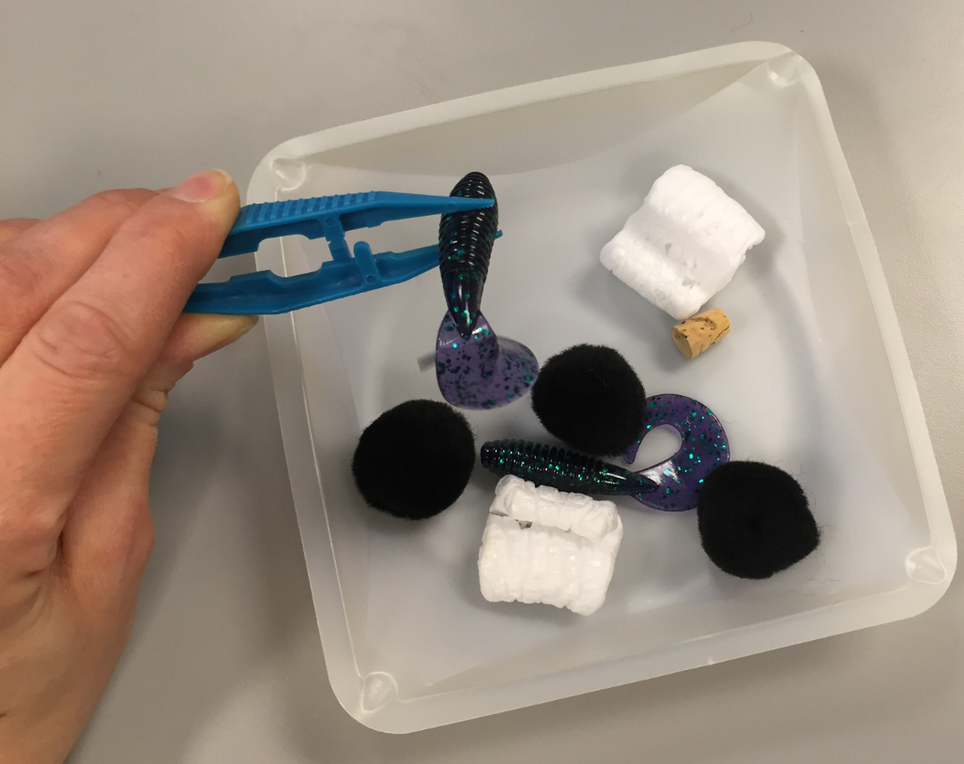
Beaks – Flinn STEM Design Challenge
Beaks In Action
3 volunteers
Rules:
Hands hold “beaks”
Play nice
No migration
Buzzer…”beaked” food to nest
Fingers can be used to remove food items from beaks
Procedure:
Using your beak, gather as much food as possible from the feeding site and place in your nest
Notes:
No migration = nest cannot be relocated

Slide 27
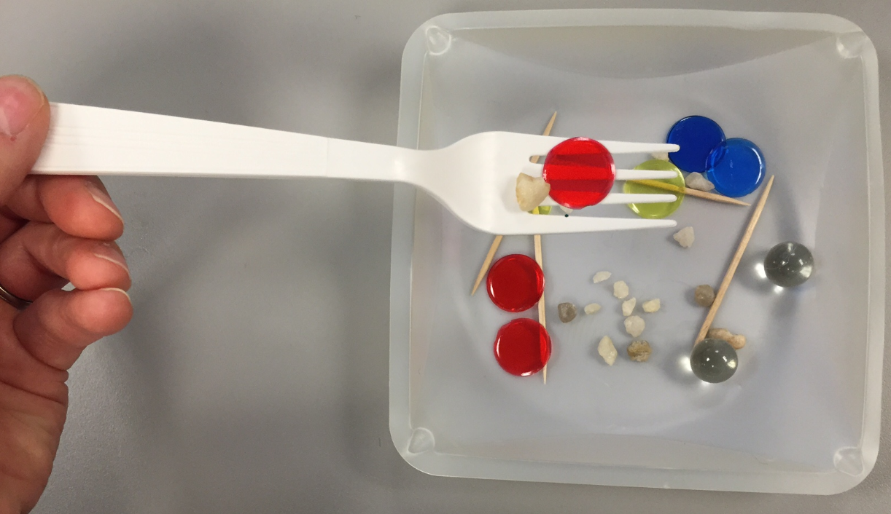
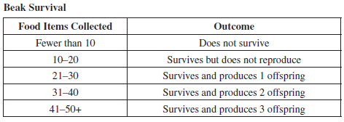
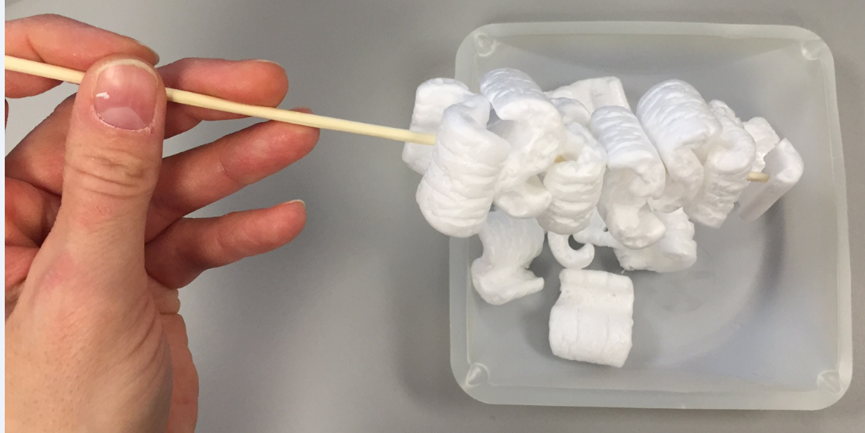
Beaks – Flinn STEM Design Challenge
Beaks In Action
Survival
Add students according to the “outcomes”
Between generations 3 and 4, environmental conditions change
Food available changes
Notes:
Trends at Flinn –
Soft foods - skewer was best (stab the packing peanuts, gathering many at each feeding)
Dry foods – skewers eliminated in one generation, and forks became the dominant phenotype

Slide 28
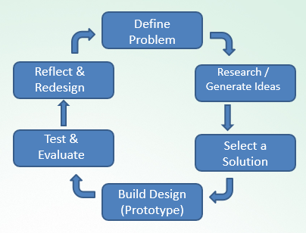
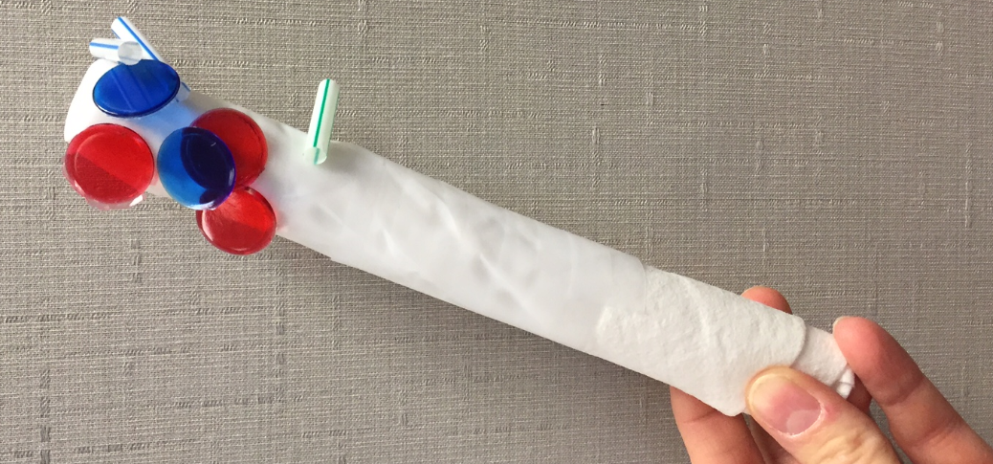
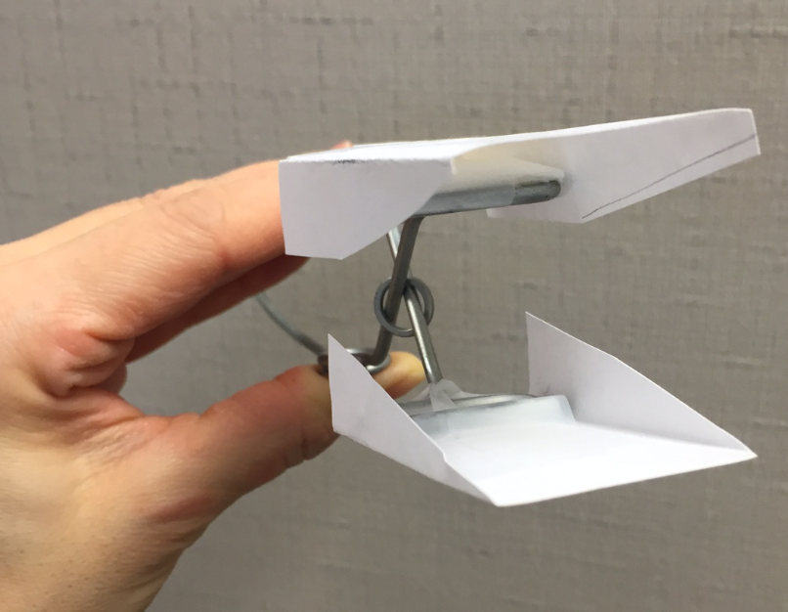
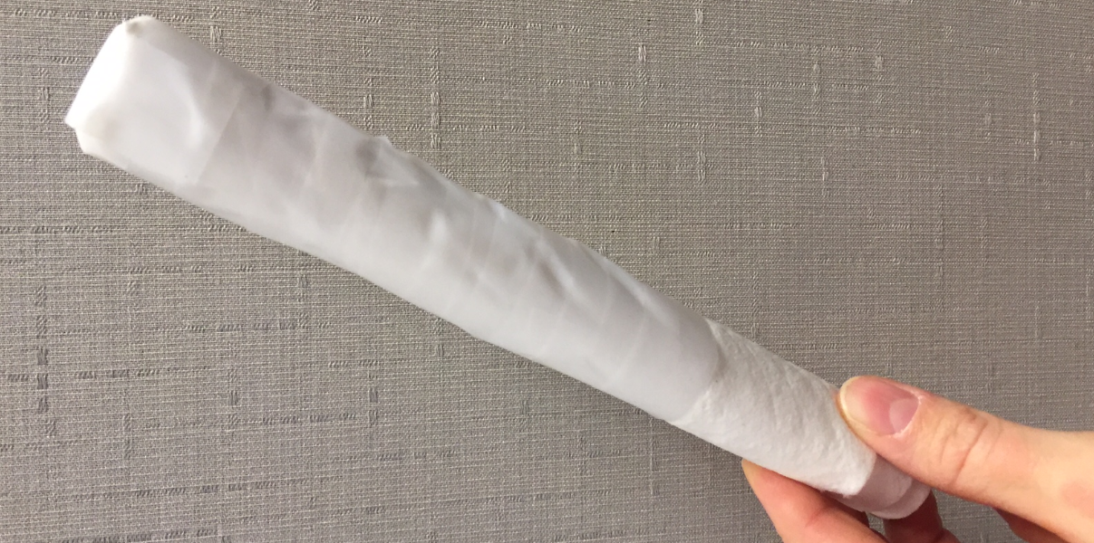
Beaks – Flinn STEM Design Challenge
Beaks In Action
Flinn STEM Design Challenge:
“Design a bird beak you believe will allow for the greatest survival chances.”
Use the Engineering Design Process
Notes:
Criteria: beak-like (hinged-jaw), original design (can’t bring in salad tongs)
Constraints: size (largest 10cm x 3cm x 5cm)

Slide 29
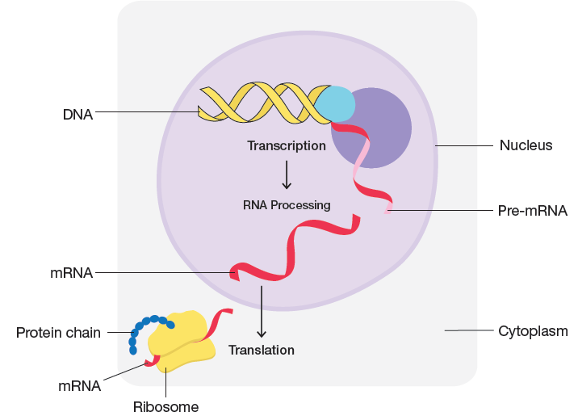
Codon
Deciphering the genetic code
Fun & challenging
Students transcribe DNA to mRNA and translate to protein

Slide 30
Codon Bingo
How to Play
Instructor randomly chooses a DNA triplet
Student transcribes DNA triplet to mRNA transcript
Students use the codon chart to translate the mRNA codon into an amino acid
Continue until …..
Notes:
If students fill in the bingo cards…
*randomly write all 20 amino acids on the card
*5 additional spaces – either repeat amino acids or use other vocabulary terms in extra spaces

Slide 31
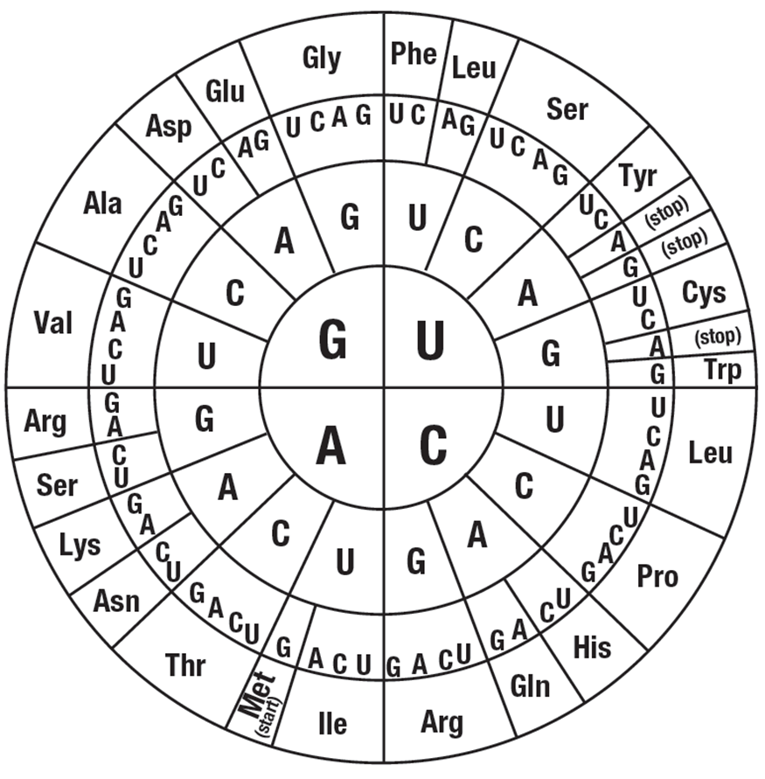
Codon
Example:
DNA triplet: C A G
mRNA transcript: G U C
Amino Acid: Val(ine)
Notes:
I did not change number of copies…not using for prize give away!
(I only included one copy of card 29 and card 32. If those are the winners it will be easier to distribute prizes. – JV)

Slide 32
Codon Bingo
1. TAC
2. TTC
3. GTA
4. GGT
5. GAT
6. Double Helix
7. CCC
8. Transcription
9. CGG
10. ACC
Notes:
Met(anine)
Lys(ine)
His(tine)
Pro(line)
Leu(cine)
Double Helix
Gly(cine)
Nucleus
Ala(nine)
Trp Tryptophan

Slide 33
RAFFLE TIME!
If you still need to hand in your blue raffle card, pass it to a Flinn Representative at this time.

