Slide 1
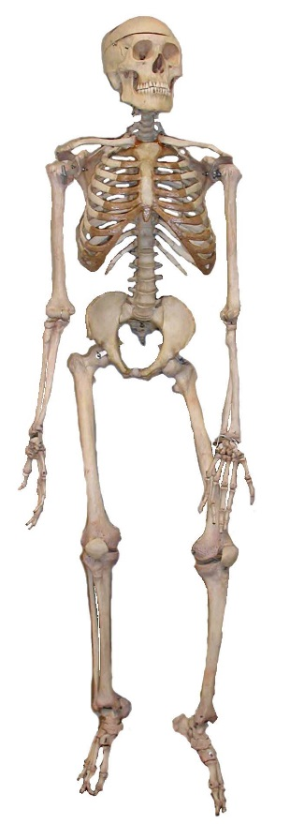

Investigating Forensics
The Application of Science to the Law
with
Meg Griffith
Staff Scientist

Slide 2
Teaching Forensics
Stand-alone course
Part of an interdisciplinary science sequence
Unit in a chemistry, biology, physics or Earth science course
As a cross-disciplinary course
How is forensics integrated into your curriculum?
Notes:
Stand alone is usually an elective. Who decides to take it? What is happening to these courses in light of new state standards? Does integration help? Can it?
Interdisciplinary – Middle level courses are interdisciplinary, especially if going to NGSS where each grade is distinct. Some high schools. IB middle years programs are encouraged to be interdisciplinary.
Stand alone or integrated into units in a traditional sequence.
Any AP or IB teachers doing forensics? AP Environmental Science has a very open structure and lends itself to Forensics in regards to pollution investigations. Any time you bring up environmental laws, you can integrated Forensics. Remember Forensics is the Application of Science to the law. May be a good fit for AP environmental science.
Environmental science is interdisciplinary.
AP and IB environmental science – Pollution is a large percentage of the curriculum. As an environmental science teacher, I taught about environmental policy and law in an integrated IB environmental systems and societies course. Bringing in forensics would be a perfect fit. This can include using water quality kits and applying forensic techniques to collect and analyze water samples.

Slide 3
Forensics and NGSS – The Practices
Asking questions and defining problems
Build or use models to illustrate the relationship between systems.
Develop or use a model to generate data to support explanations.
Analyzing and interpreting data
Mathematical and computational reasoning
Construct scientifically accurate explanations of the evidence.
Engaging in argument from evidence.
Notes:
The practices teach kids how to do science and forensics courses are all about doing science to reach a valid conclusion.
1st -Evaluate the premise of findings or interpretation of a data set. This can be used to look at the validity of forensic evidence. What it can and cannot prove. How do you do this in your courses. Define a design problem and develop processes and criteria with social or environmental considerations. While typically this is thought of an engineering prompt, it is a great fit for forensics. The law is all about social considerations and modifying the social constructs of a society.
2nd – Model crime scenes to explain crimes using data collected – Bullet hole analysis, blood spatter data, fiber, etc.
3rd – Recreating the conditions of the crime scene allows students to collect repetitive data sets to see if their claim fits the data from the model.
4th – Qualitative analysis, quantitative analysis. Being able to use evidence to exclude suspects vs. to implicate suspects.
Use Claims – Evidence – Reasoning to defend findings. Apply statistics to the data to evaluate the significance of the findings. Evaluate the reliability of the evidence to reason a conclusion.
5th – Today we will look at bullet hole analysis, which uses geometry and trigonometry to recreate the position of the shooter. Measuring and comparing quantitative data.
6th: How good is the evidence? Is it good enough to convict? Is it good enough to assign blame or culpability? To what extent does the evidence support or refute the claim? This is when kids learn to reason. By bringing in some arguments of validity of the evidence, see if students can devise new ways to test or new evidence to collect from a crime scene that hasn’t been done before. This practice includes having students design solutions to real world problems. Generally, we think of this as an engineering solution that should be built. However, it can also be a better way to analyze crime science evidence.
The 7th practice is ideal for a Forensics unit or course. Hold a mock trial. Have students convince the DA (you) to bring charges or approve a warrant. Have students file mock law suits claiming environmental harm. What additional evidence is needed to clear up contradictions or conflicting analysis of the evidence? Defend a claim based on student-generated evidence.

Slide 4
Forensics and NGSS – Disciplinary Core Ideas
You get to customize and take content from all the major disciplines!
HS-PS1.A: The structure and interactions of matter at the bulk scale are determined by electrical forces within and between atoms. (Chromatography, Fiber Analysis, Gel Electrophoresis)
HS-PS3.B: Conservation of Energy and Energy Flow. (Bullet trajectory)
HS-LS3.A: Inheritance of traits (DNA analysis)

Slide 5
Forensics and NGSS – Crosscutting Concepts
Case studies integrate concepts with common threads.
Pattern recognition
Today you will see activities that reinforce the patterns and cause and effect CCC
Notes:
When teachers use cases based on real disputes or crimes, integration of biology, chemistry, math and physics will happen. Students are able to understand the complexity of analysis.
One example is NGSS CCC such as patterns can be used to understand cause and effect relationships concerning gun shot reconstruction or ballistics information. The separation of pigments using chromatography relies on the repeatability of the pattern of separation and the recognition that the properties of molecules cause the pigments to separate in the ways that they do.

Slide 6
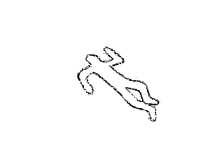
Agenda
Forensic Footwear Evidence – Demonstration
Ink Identification using Chromatography – Hands on!
Fiber Findings
Bullet Trajectory Analysis
Forensic Glow-blood

Slide 7
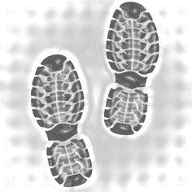
Forensic Footwear Evidence
Every crime has an entry and exit.
Shoe impressions hard to conceal.
Come in two forms:
Prints
Impressions

Slide 8
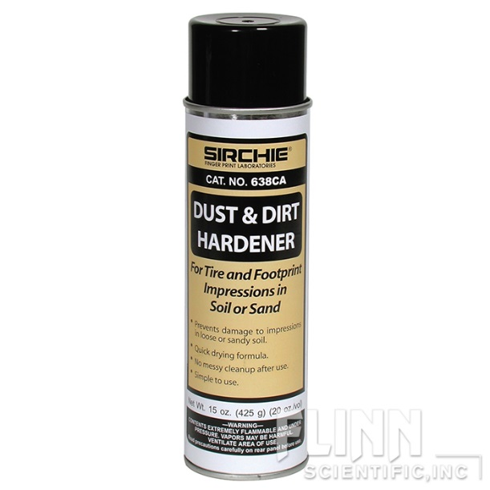
How to Take a Footwear Impression
Locate the footprint.
Spray the medium with dust or dirt hardener.
Surround the footprint with a casting frame.
Mix Shake-N-Cast™ and pour.
Wait 30 minutes and remove your impression.
Brush the dirt away with a beaker brush or similar.

Slide 9
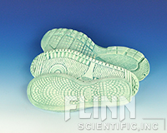

Practice Footwear Impressions Using BioFoam®
Practice taking footwear impressions in the lab before trying it in the field.
Notes:
START FOOTWEAR IMPRESSION HERE!!! Pass around the samples. Get a volunteer (ask ahead of time when people are first coming in.)

Slide 10
Practice Footwear Impressions Using BioFoam®
Footwear impression analysis teaches:
Pattern recognition
Attention to detail
Qualitative analysis
Argument from evidence
Notes:
START FOOTWEAR IMPRESSION HERE!!! Pass around the samples. Get a volunteer (ask ahead of time when people are first coming in.)
How does this activity benefit students? Practice with pattern recognition and matching is the most obvious. Attention to detail helps students see if partial prints can be matched. Students can set up a ranking system to communicate how well and how confident they are with the match. This teaches them how to be more objective with qualitative analysis of evidence. Finally, this helps students practice argument from evidence in small teams. They have to come to a consensus on this evidence so they will have to practice convincing each other of the value of the evidence.

Slide 11

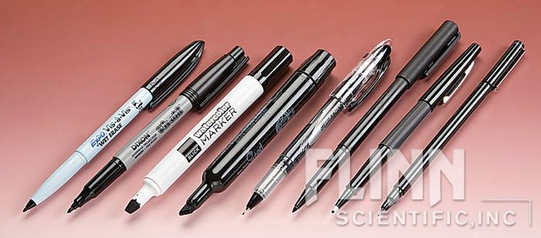
Ink Identification using Chromatography
Radial chromatography
Separate compounds for identification.
Easy, fun and uses no organic solvents.
Adsorbent is filter paper
Eluent is water.
Notes:
Chromatography is the separation of compounds in order to identify the components of a solution or mixture.
Ink is a mixture of pigments and many inks are water soluble.
That means you do not have to use acetone, alcohol, or hexanes to separate the pigments.
The adsorbent, which is the matrix the pigments move through, is inexpensive filter paper. Use qualitative filter paper (faster separation) in medium to large size for best results (Show examples)

Slide 12
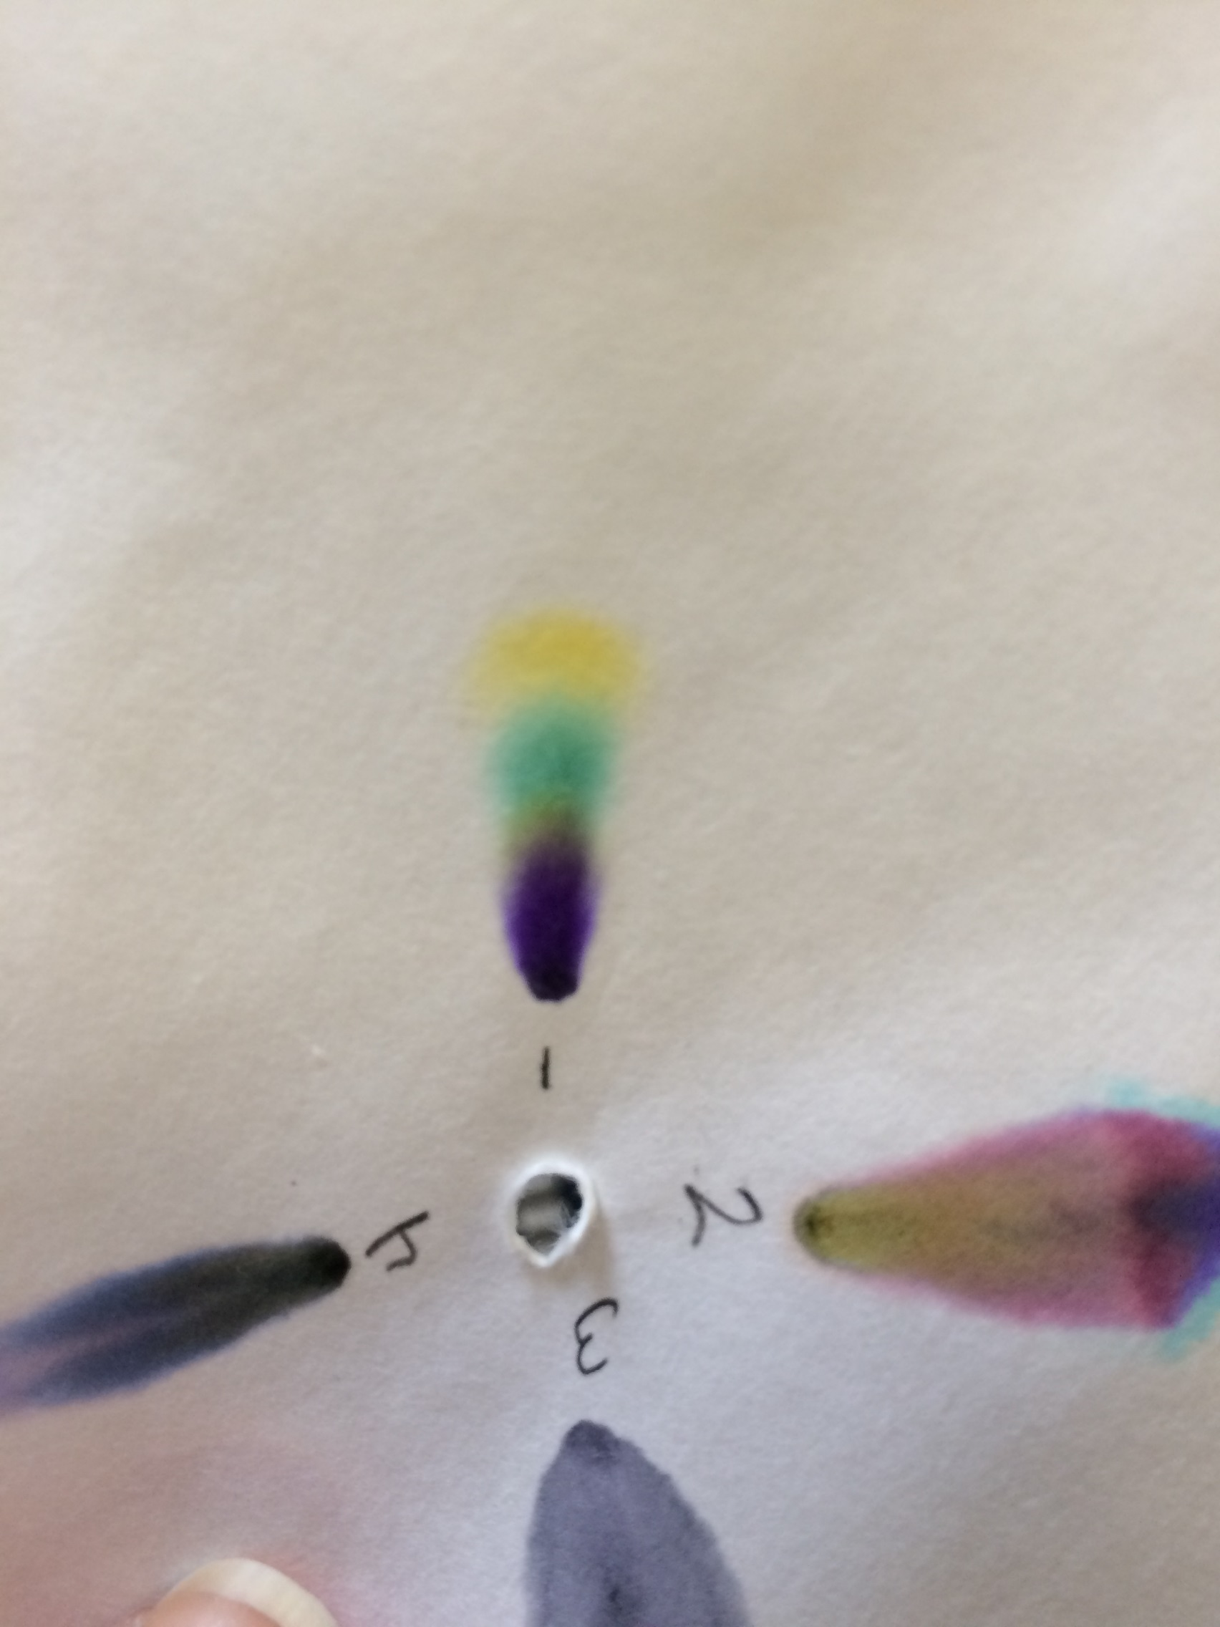
Ink Identification using Chromatography
Crime Set-up:
Banks around town are reporting an increase in fraudulent checks!
The ink used to write the fraudulent checks was analyzed using chromatography.
In most cases, the chromatography evidence shows the pattern to the right.
Determine which of three pens, found in three different suspect’s houses matches the checks.

Slide 13
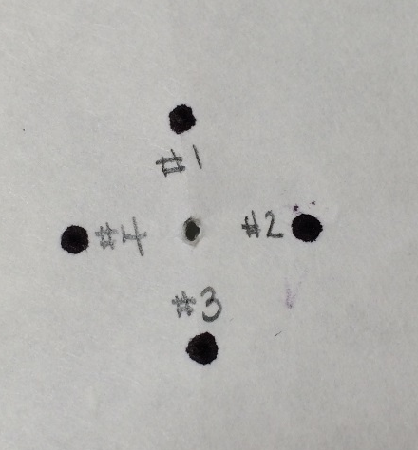
Ink Identification Using Chromatography
Water is very polar.
Differences in polarity will increase or decrease the solubility of molecules that make up ink.
Pigments in water soluble pen ink will separate at different rates because of their different polarities.
Notes:
Do the demonstration here.
Please take out your kits and join a group of 4.
Each person Poke a hole in the center of a piece of filter paper.
Place an ink dot from each pen around the center and number them with pencil
Cut one of the filter papers into 8 pie-shaped pieces. Each person needs one of these pieces
Roll the wedge of filter paper into a cone a insert into the hole of the filter paper. This will be the wick to wick water up to the filter paper disk.
Fill the plastic cup about half way with water. You need the wick to reach the water.
Place the filter paper with wick on top of the cut. Set aside for about 30 min. We will come back to this later.
You want to make sure your students understand why the pigments separate. Water is a polar molecule, meaning it has a positively charged side and a negatively charged side.
The ink pigments also have polarity, although the amount varies between the different pigments and the molecules are different sizes. The filter paper is much less polar than water so pigments that are less polar or not polar will stick to the filter paper and either not move or move slowly.

Slide 14
Fiber Findings
Crime lab examines fibers to exclude suspects
Appearance is examined
Burn test
Dye affinity
Notes:
Fibers found at a crime scene are collected and sent for analysis. What does this mean? Fibers are compared to known samples. Appearance, burning, physical properties, chemical properties. Two specific tests are a burn test and a dye affinity test (shown at the right)
HAVE DYE WARM AND TURN ON THE HOTPLATE NOW!!

Slide 15
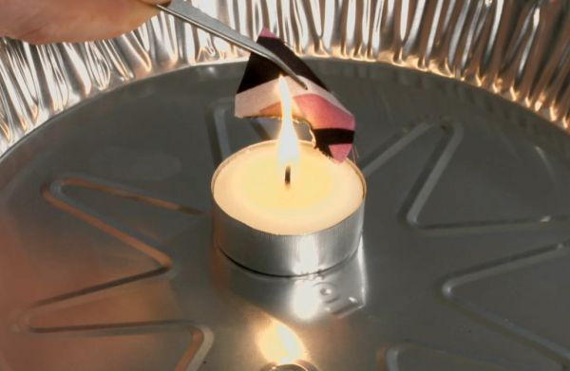
Fiber Findings− Burn Test
Bring fiber near the flame.
Ignite fibers that do not melt. Observe easy of igniting, strength and speed of burn
Observe odor
Use ventilation fans or a hood.
Notes:
Light a candle in a metal pie plate or other non-flammable container. Hold the fabric sample with tongs and bring it near the flame. If it melts or curls it is a synthetic fabric such as nylon. If it melts, do not try to ignite it. Reduce exposure to fumes by not continuing with the flame test on those fabrics that melt. Ignite fibers that do not melt and drop into the pie plate. Some types of fabric will burn with a steady flame and ignite easily. Some will be difficult to light and flicker or burn slowly. These are likely wool and cotton or linen.
smells of burnt hair the fiber is likely wool. If it smells of burning paper it indicates presence of cotton, rayon or linen.

Slide 16
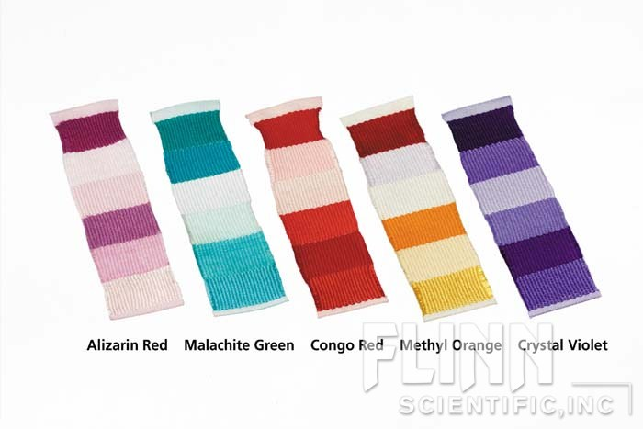
Fiber Findings−Dye Affinity
Chemistry of fiber dyes: water soluble, charged compounds
Animal fibers are easier to dye than plant fibers.
Wool fibers have several dye sites that attract dye molecules.
Can be ionic or polar.
Dyes bind better to natural fibers than synthetic.

Slide 17
Fiber Findings – Dye Affinity
Wool:
Acrylic:
Polyester:
Nylon:
Cotton:
Acetate:
Dark, natural fiber with many dye sites.
Light, synthetic with fewer dye sites.
Light, synthetic with fewer dye sites.
Medium, synthetic with polar dye sites.
Med/Dark, natural plant fiber with many dye site
Light, synthetic, fewer dye sites.
Notes:
Make predictions of how dye will adhere to the following materials based on information from the previous slide. IF time have teachers talk amongst themselves about which ones will do what.

Slide 18
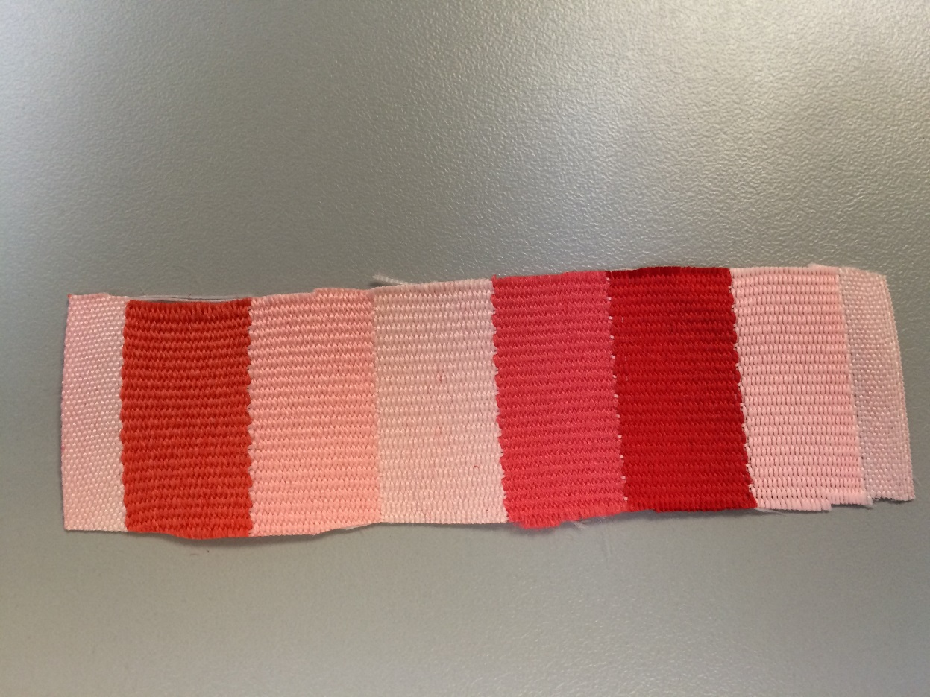
Fiber Findings Results
Wool
Acrylic
Polyester
Nylon
Cotton
Acetate
Notes:
This reinforces the same physical science concept as the chromatography. Students are investigating how you can get evidence about the behavior and structure of molecules based on the outcomes of a macroscale experiment. Student should be able to apply the concept of molecular interactions to these results. For example Polyester and acetate have few dye binding sites, which are charged locations, than wool and cotton.

Slide 19
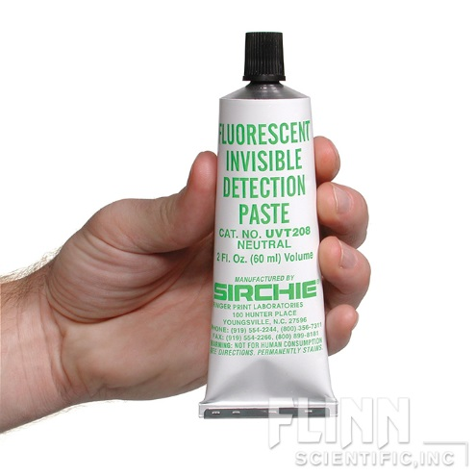
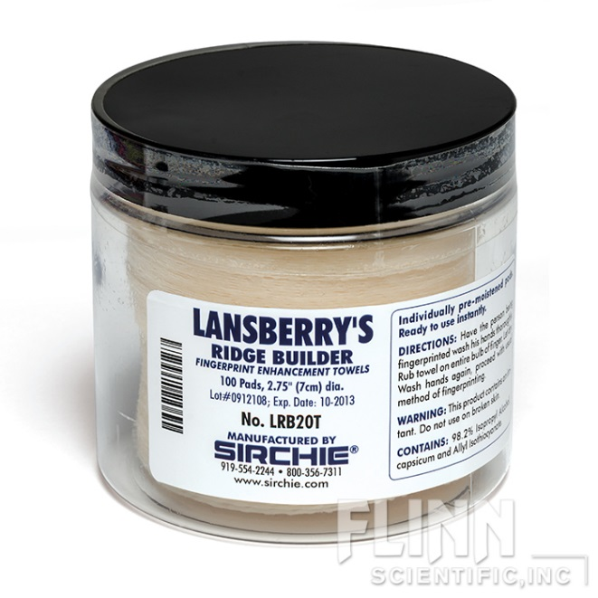
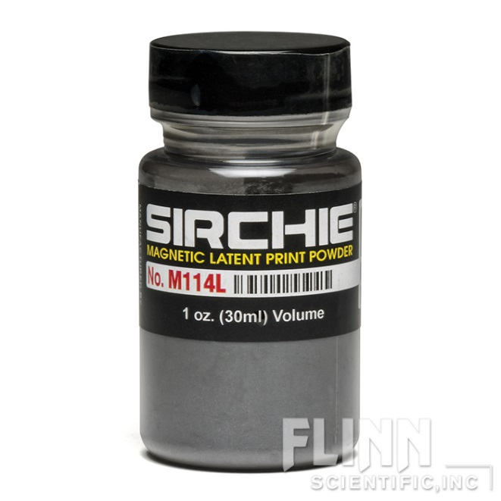
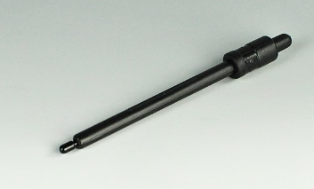
Forensics Products
Fluorescent Detection Paste (AP7858)
Lansberry’s Ridge Developer (AP7814)
Magnetic Fingerprint Powder and applicator
(AP7763 & AP7764)
Notes:
Use this slide to feature some interesting forensics items in our product line.

Slide 20
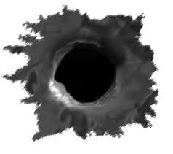
Analyzing Bullets and Ballistics
What type of gun was used.
The approximate distance between the gun and the entry point.
The position of the shooter.
What can it be used for?
Notes:
Ballistics is the study of the flight path of bullets or other projectiles. Bullets and firearms are also examined to determine which gun or gun model may have been used. We will focus specifically on flight path in this scenario. The flight path can be accurately recreated when a bullet enters at least two objects using “stringing”. Stringing involves using string or dowels through the two bullet holes to estimate the trajectory based on angle. If the bullet only enters one object, an estimate can be done using the bullet hole shape. While not as accurate it can either confirm or exclude witness or suspect accounts of the incident.
So, I will show you a potential scenario in which you could use a single entry bullet hole estimation to corroborate an account.

Slide 21
Bullet Trajectory Analysis - Scenario
You are investigating a homicide and take a look at the case file. Here’s what you know about the ballistics from the file:
A shooting occurred at the home of Mr. D.
A gun registered to Mr. D was found at the scene with three bullets missing from the chamber.
Two bullets struck the victim and killed him.
One bullet was lodged in the wall.
Three shell casing were found near the body.
Notes:
These are the notes taken from the on-scene officer about the gun and bullets in a shooting death being investigated as a homicide.

Slide 22
Questioning Mr. D
Here is what he said happened:
“Mr. M is my neighbor and he came over upset about my dog barking. He started getting really mad and threatened me. I always keep a loaded gun nearby, so I showed it to him. To tell him, hey back off.
He grabbed for the gun and wrestled me to the ground. In the scuffle, the gun went off and the bullet hit the wall. He was still going for the gun, so when I had the chance, I shot him twice. It was self defense.”
Notes:
Before going any further, you decide it would be a good idea to check out the sketches of the scene to see if Mr. D’s story holds up. Their aren’t any other witnesses and some of the other evidence is going to take a few days to process.

Slide 23
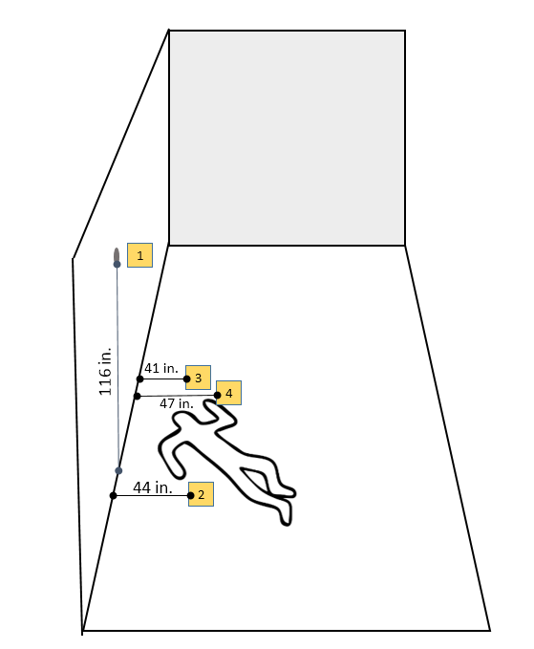
The sketch shows the bullet hole in the wall (1) and the three bullet casings. (2-4)
Crime Scene Sketch
Notes:
With this information, detectives checked the preliminary sketch of the scene from the investigator showing the location of the bullet hole and the three bullet casings.
What did Mr. D say was happening when the bullet hole was made? Could that bullet hole be in that location considering where the casing are? With only one entry point, we will have to do some fancy math to see if Mr. D’s story holds up. Looking through the file you notice a close-up of the bullet hole with measurements. Ok, let’s see if Mr. D is telling the truth about the scuffle with victim.

Slide 24
Bullet Trajectory Analysis
Here’s a sketch of the bullet hole.
It was 116 inches from the floor.
The impact angle is angle at which the bullet hits the wall.
Impact angle is determined based on bullet hole shape.
Notes:
In the file, you find photographs and this sketch showing the dimensions of the bullet hole. From the photographs, you can see that the bullet was shot from below, creating this elliptical hole in the wall.
Your goal is to determine the angle at which the bullet struck the wall. Since the room is small, you get to assume the bullet was not effected by gravity. So, the angle that the bullet struck the wall and the angle at which the gun fired the bullet will make up two angle of a right triangle.
First we will find the impact angle. This one is tricky to understand because you have to know a little bit about the behavior of the bullet and how it ends up making the ellipse in the wall. The width of the bullet hole, also called the minor aixs, is equal to the width of the bullet. The height of the bullet hole, also called the major axis is not the same as the width because of the angle of the bullet.

Slide 25
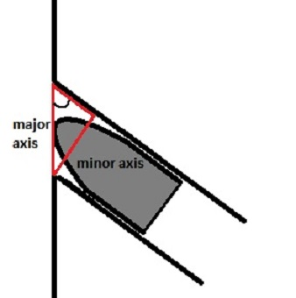

Bullet Trajectory Analysis – Impact Angle
Minor axis – width of the hole. 13 mm
Major axis – length of the hole. 19 mm
We can relate these two using the sine function:
$$\sin\left(impact angle\right)=\frac{minor axis}{major axis}$$
$$\sin\left(impact angle\right)=\frac{13 mm}{19 mm}$$
$$Impact angle=\sin^{−1}{0.68 }$$
$$Impact angle=43$$
Notes:
When we look at the hole, we notice that the shape is an ellipse. An ellipse has two axes. The minor axis and the major axis. We can relate these two measurements to another angle formed between the diameter of the bullet and the length of the hole in the wall. Connect these to form a right triangle. In this case we know the measurements for one leg of the triangle and the hypotenuse. We can use the Sin function to determine the impact angle.
Go over items in the kit. The bullets, footprints, etc are used to calculate the height of the shooter.

Slide 26
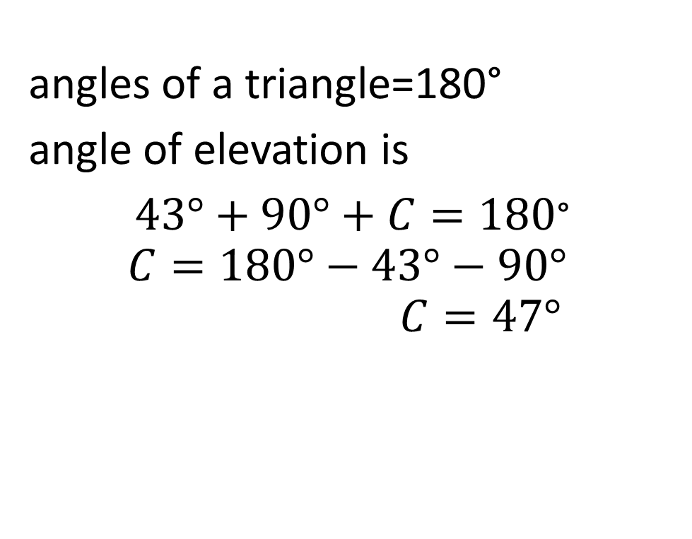
Bullet Trajectory Analysis
Determine the height of the gun
angles of a triangle=180°
angle of elevation is
$43°+90°+C=180$°
$$C=180°−43°−90°$$
$$C=47°$$

Slide 27
Bullet Trajectory Analysis
Summary of Current Information:
Impact Angle: 43°
Angle of Elevation: 47°
Distance from ground to bullet hole: 116 in
Max distance from the wall to the gun at the time of the shot: 60 in
Notes:
Side b can be estimated based on the shell casing and body. It’s helpful to think about the furthest away the gun could have been. In this case, 60 inches would be the furthest that can be anticipated. It was likely closer.
.

Slide 28
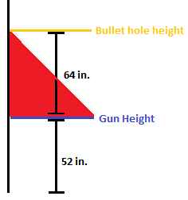
Bullet Trajectory Analysis
Calculate the height (H) of the triangle,
Determine the height of the gun (G)
Subtract H from the bullet hole height to get G
H
G

Slide 29
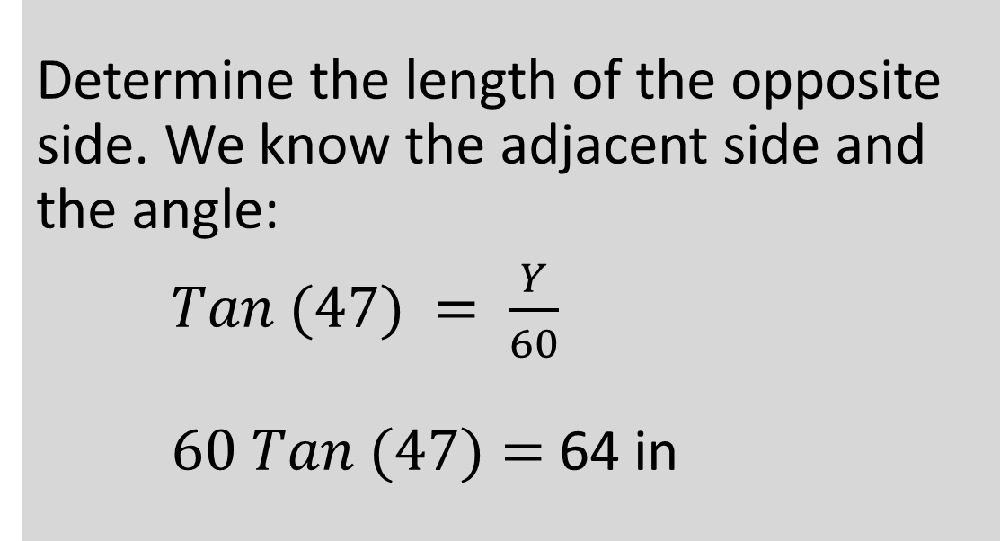
Bullet Trajectory Analysis
Determine the vertical distance between the gun and the bullet hole.
Determine the length of the opposite side. We know the adjacent side and the angle:
$Tan (47) = \frac{Y}{60}$
$60 Tan (47)=$ 64 in
Notes:
We will use the tangent of the angle of elevation and length of the adjacent side, which is estimated to be a maximum of 60 inches from the wall. This will give us the vertical distance between the gun and the bullet hole.
This means the gun was about 64 inches below the bullet hole when it was shot. Could the suspect have been wrestling on the ground when the gun went off?

Slide 30
Bullet Trajectory Analysis
Determine the Height of the Gun
Gun height = distance from bullet to ground – vertical distance between the gun and the bullet hole
= 116” – 64”
= 52”
This is the minimum height of the gun.
Notes:
The gun was at least 52 inches from the ground when it discharged. That is 4 ft, 4 inches. Mr. D is probably not telling the truth. Once other evidence comes back about the gun powder residue, blood splatter analysis and other things taken from the scene, they may have a clearer picture of what exactly happened.

Slide 31
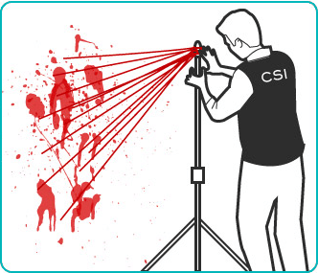
Forensic Glow-Blood
Some crimes leave behind blood stains.
Blood stains can indicate positions and movement of victims.
Reconstruct crime scenes.

Slide 32
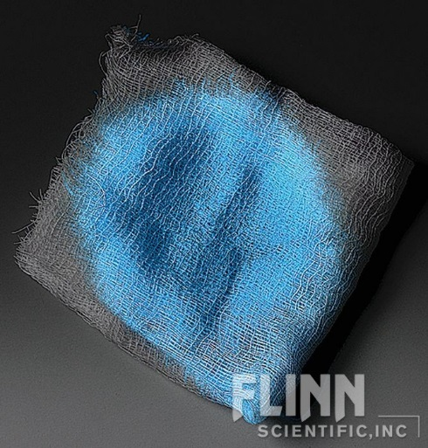
Forensic Glow-Blood
How do you find small areas of blood at a crime scene?
Using chemilluminescent blood detection spray!
LUMINOL will glow in the presence of blood.

Slide 33
Forensic Glow-Blood
To glow, luminol requires:
An oxidizing agent
An alkaline pH
Catalyst (copper or iron)
When detection spray and blood react:
Iron in the blood acts as a catalyst.
Electrons in the detection spray enter an excited state.
Electrons relax to ground state and light energy is released.
Notes:
See CF8627 for scientific details/explanation. Luminescent blood detection spray is a proprietary mixture containing base resulting in an alkaline pH, when mixed with hydrogen peroxide (oxidizing agent) it will glow when in contact with blood because of the blood’s iron content.

Slide 34
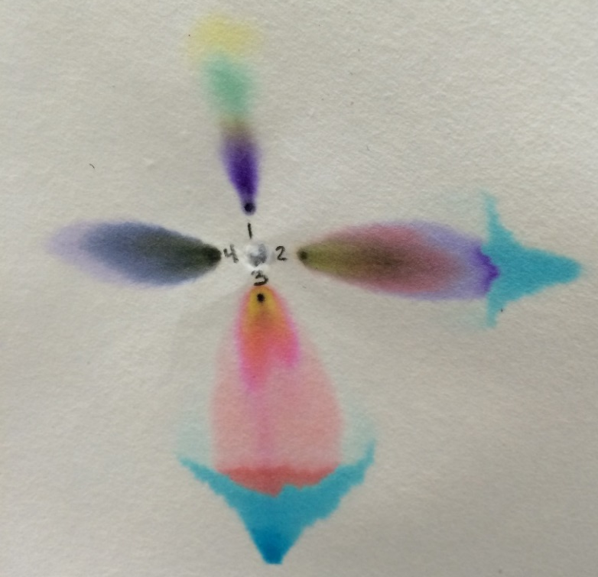
Ink Identification Using Chromatography
Use chromatography to analyze ink used to write a fraudulent check.
Three possible pens were tested to determine if any of them match the evidence sample.
Notes:
Instruct students to remove their chromatogram from the water. Go over results.

Slide 35



If you have any questions we would love to hear from you!
800-452-1261
flinn@flinnsci.com

