Slide 1
Welcome!
Flinn Scientific Advanced Inquiry Labs for
AP* Physics 1 & 2
Gus Alvarez
*AP is a registered trademark of the College Board, which was
not involved in the production of, and does not endorse, this product.

Slide 2
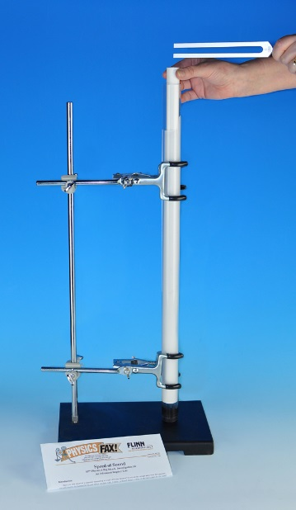
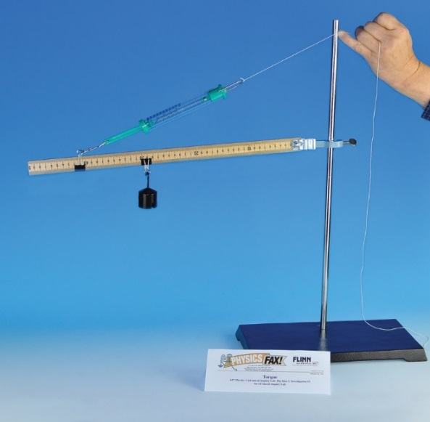
Today’s Workshop
Advanced inquiry labs from Flinn Scientific
Speed of Sound
Torque
Fluid Dynamics
Electromagnetic Induction

Slide 3
Revised AP Physics Curriculum
Seven Big Ideas
Seven Science Practices
Emphasis on Inquiry: “25 percent of the instructional time must be spent in hands-on laboratory work, with an emphasis on inquiry based investigations that provide students with opportunities to apply the science practices.”

Slide 4
Flinn’s Advanced Inquiry Labs – AP Physics 1
Measuring g: Exploring Free-Fall
Newton’s Second Law
Graphing Motion
Coefficient of Friction
Uniform Circular Motion
Conservation of Linear Momentum
Conservation of Energy on An Inclined Plane
Conservation of Elastic Potential Energy
Hooke’s Law and Simple Harmonic Motion
Torque
Simple Pendulums
Rotational Motion and Angular Momentum
Mechanical Waves
Electrical Circuits
Speed of Sound
Resistance and Resistivity

Slide 5
Flinn’s Advanced Inquiry Labs – AP Physics 2
Archimedes' Principle and Buoyancy
Fluid Dynamics
Boyle’s Law
Thermal Conductivity
Investigating Electric Charge
Electric Field Mapping
Capacitance and RC Circuits
Kirchoff’s Rules
A Magnetism Investigation
Electromagnetic Induction
Reflection and Mirrors
Refraction and Lenses
Diffraction
The Photoelectric Effect
Modern Topics

Slide 7
Format for Advanced Inquiry Labs
Background
Experiment Overview
Pre-Lab Questions – safety, principles and calculations, e.g., percent error
Introductory Activity – introduce lab technique, “rough” exp’t to select range, etc.
Guided Inquiry Design and Procedure – inquiry guidance provided by leading questions
AP Physics Review Questions – integrate inquiry, content, and reasoning
Teacher’s Notes

Slide 8
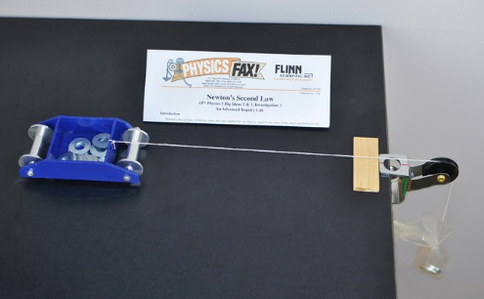
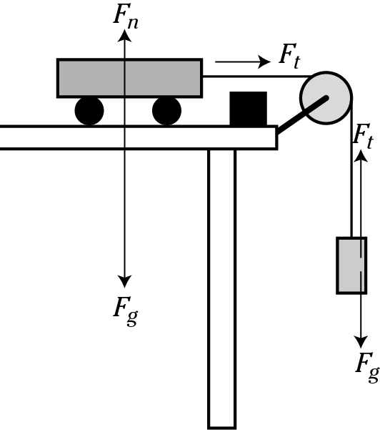
Newton’s Second Law
Big Ideas 2 and 3
Explore the relationships between Force and acceleration and mass and acceleration
Modified Atwood’s machine: a simple rolling cart, washers, table pulley, string, pine board, and a plastic bag

Slide 9
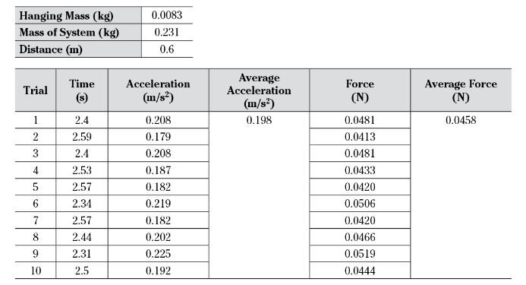
Introductory Activity
Measure time it takes a cart of prescribed mass to move a prescribed distance
a = 2d/t²
F = m_{s}a

Slide 10
Guided Inquiry Procedure
Explore the relationship between Force and Acceleration
Explore the relationship between Acceleration and Mass
- identify independent and dependent variables
- identify variables that should be held constant

Slide 11
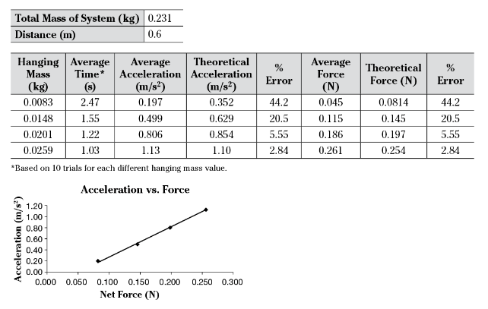
Data and Results

Slide 12
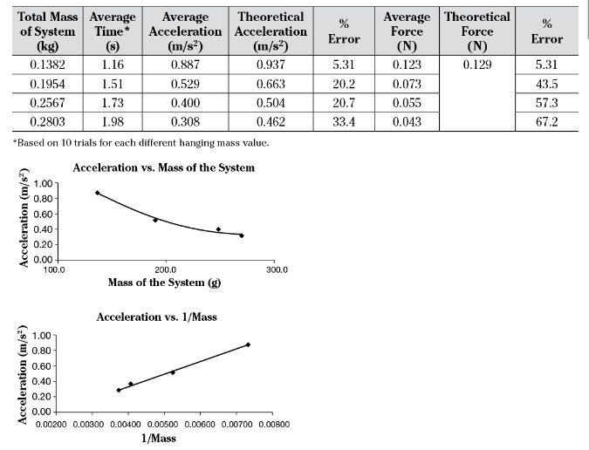
Data and Results

Slide 13
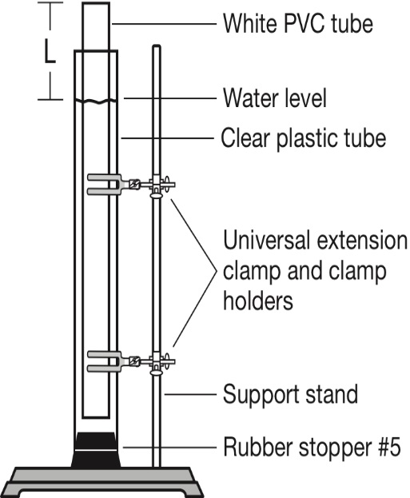
Speed of Sound – Advanced Inquiry Lab
Big Idea 6 (Waves), Investigation 14
Investigate methods for measuring the speed of sound in air.
Two techniques
Using echoes
Closed-end air column using tuning forks of known frequencies

Slide 14
Introductory Cooperative Class Activity
Determine the Speed of Sound with Echoes
Trial | Time for 20 Claps/Echoes (s) | Time for 1 Echo (s)
1 | 5.40 | 0.27
2 | 4.88 | 0.24
3 | 4.97 | 0.25
4 | 4.72 | 0.24
5 | 5.16 | 0.26
6 | 4.93 | 0.25
7 | 5.31 | 0.27
8 | 5.09 | 0.26
9 | 5.24 | 0.26
10 | 5.21 | 0.26
Avg. | 5.07 | 0.26
Distance to
Wall: 45 m
Temperature:
23.5 °C
Calculated speed of sound: 360 m/s

Slide 15
Guided-Inquiry Design and Procedure
Consider a tuning fork with a known frequency used to drive a sound wave in a closed tube.
Explain the relationship of the frequency to the length of the air column and the speed of the sound wave when resonance is achieved.
Describe how the setup pictured might
be used to create resonance at different
frequencies and design an experiment to
measure the speed of sound.

Slide 16
Speed of Sound - Analysis and Conclusions
Calculate speed of sound in closed tube.
Temperature of air in tube: 21.7 °C
Tuning Fork Frequency, Hz | Air Column Length, L (m) | Calculated Wavelength, λ = 4L (m) | Calculated Speed of Sound, v = fλ (m/s)
256 | 0.338 | 1.35 | 345.6
288 | 0.313 | 1.25 | 360.0
320 | 0.262 | 1.05 | 336.0
341.3 | 0.250 | 1.00 | 341.3
384 | 0.222 | 0.89 | 341.8
426.7 | 0.195 | 0.78 | 332.8
480 | 0.186 | 0.74 | 355.2
512 | 0.168 | 0.67 | 343.0

Slide 17
Since f = 86.073/L and f = v/4L, v = 4(86.073) = 344.3 m/s.

Slide 18
Speed of Sound - Analysis and Conclusions
Calculate theoretical speed of sound for air in tube and determine percent error.
331.4 + (0.6 m/s) x 21.7 °C = 344.4 m/s
°C
Percent error = 0.03%
Identify sources of systematic error and random error.
Compare accuracy of two methods of determining the speed of sound in air.

Slide 19
Torque – Advanced Inquiry Lab
Big Idea 3
Investigate forces necessary to achieve static equilibrium for various combinations of levers and forces
Design a structurally safe and low-cost method for hanging a sign

Slide 20
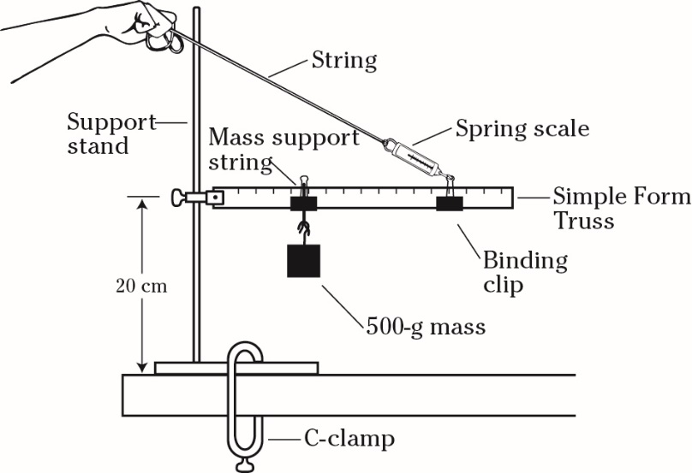
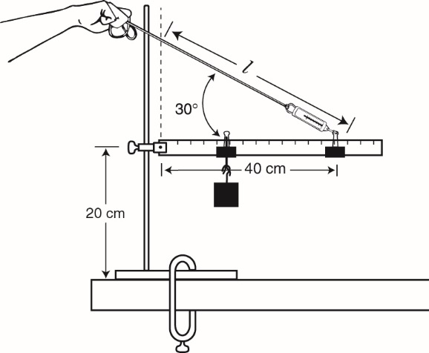
Introductory Activity
Set up simple form truss, gain familiarity with equipment

Slide 21
Guided Inquiry Activity
Answer leading questions to develop familiarity with equipment and the principles of torque
Devise a procedure to optimize a hanging-sign model at low cost

Slide 22
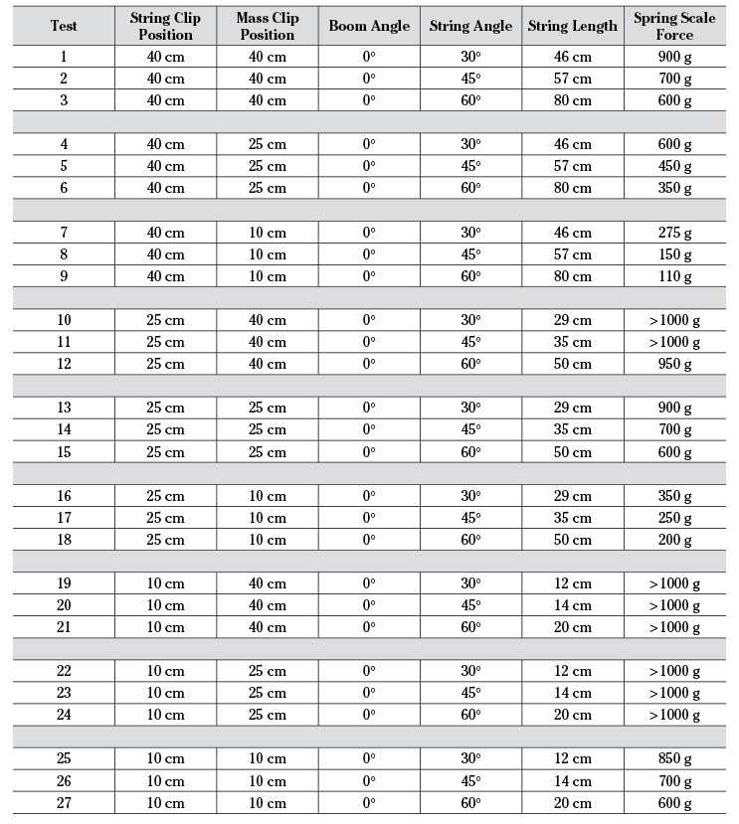

Slide 23
Fluid Dynamics – Advanced Inquiry Lab
Big Ideas 1 and 5 – Investigation 2
Determine the continuity equation with a class intro activity
Build upon learned concepts to determine speed of fluid exiting hole at bottom of a container via a student designed procedure.

Slide 24
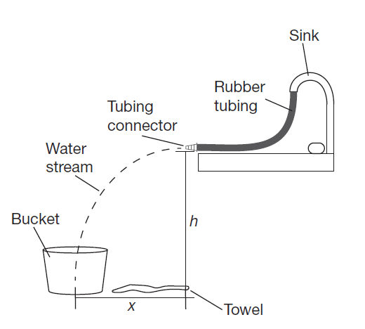
Introductory Activity
Cooperative class activity
Designed with the general physics classroom in mind (generally one sink at the most.)
Use sink, rubber tube and tubing connectors of differing cross-sectional areas to determine conservation of mass flow.
Adapt as needed

Slide 25
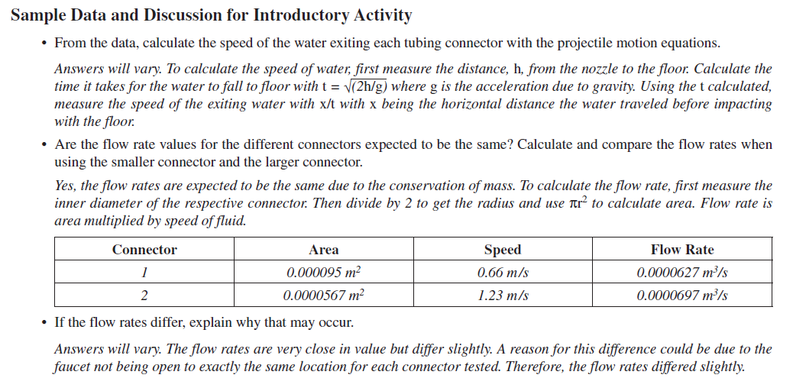
Data and Analysis – Introductory Activity Teacher Notes

Slide 26
Guided Inquiry Activity
Answer guiding questions relating to the apparatus.
Design an experiment that uses the apparatus provided to derive the mathematical relationship between fluid depth and the speed at which the fluid exits the container.

Slide 27
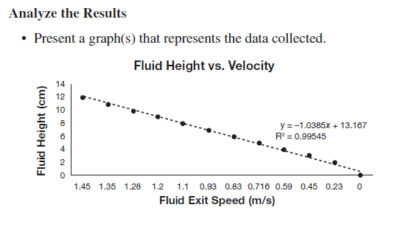
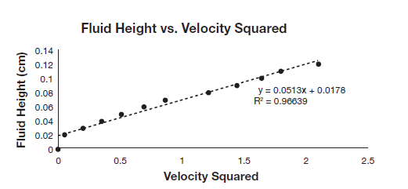
Data and Analysis- Guided Inquiry Teacher Notes

Slide 28
Electromagnetic Induction – Advanced Inquiry Lab
Big Idea 4, Investigation 10
Discover electromagnetic induction.
Students are challenged to use newly learned concepts to light an LED with an induced current.

Slide 29
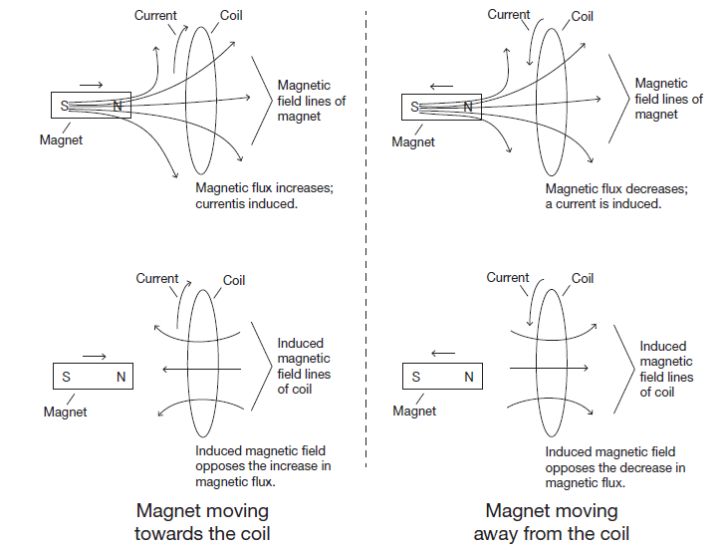
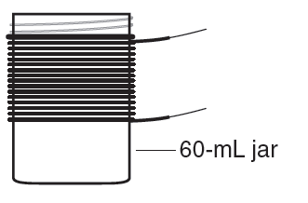
Introductory Activity
“Cookie cutter” style to familiarize students with an unfamiliar phenomena: induced currents, field flux and changing flux.
Use two strong neodymium magnets, a coil of wire and galvanometer to observe the effects of changing magnetic flux on a coil.

Slide 30
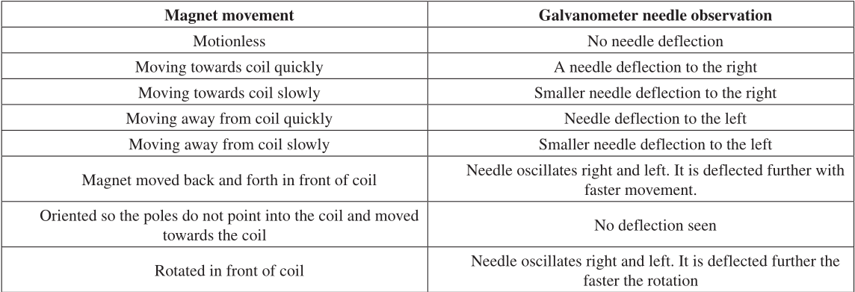
Data and Analysis – Introductory Activity Teacher Notes

Slide 31
Guided Inquiry Activity
As a group, students answer guiding questions to determine the key variables that play a role in electromagnetic induction.
The group is challenged to use the materials given to light the LED.
The group must have its experiment design approved by the instructor before proceeding. Levels of guidance may be determined by the instructor.

Slide 32
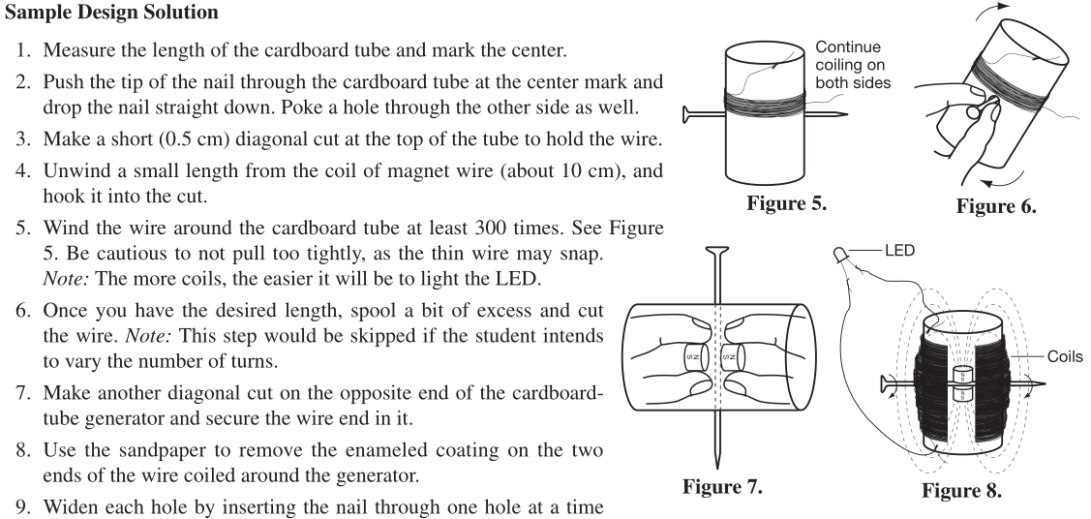
Data and Analysis- Guided Inquiry Teacher Notes

Slide 33
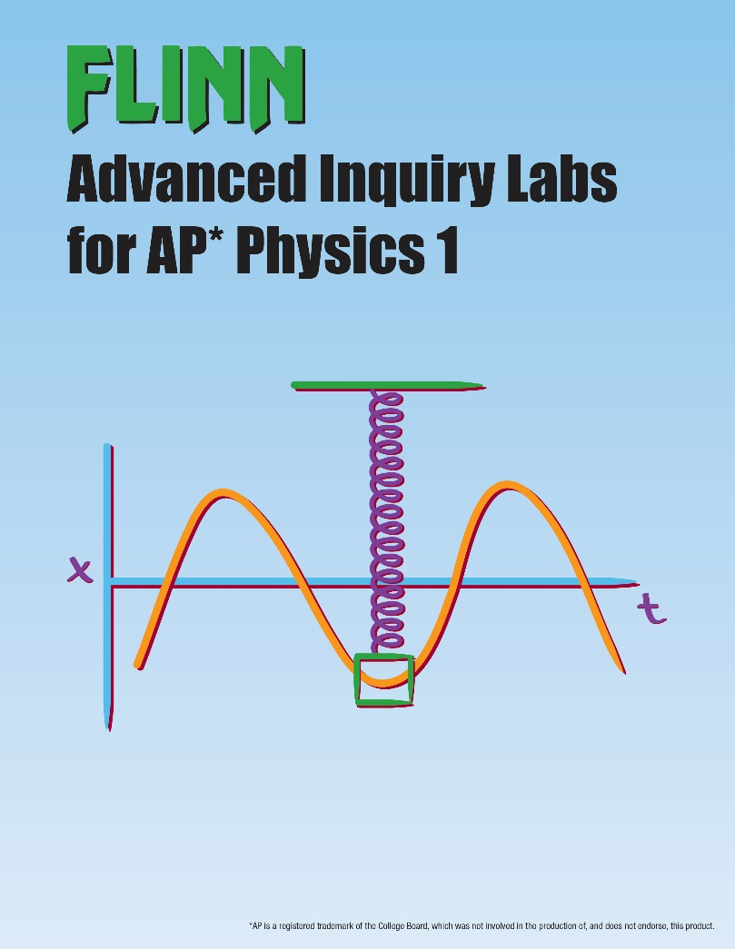
Advanced Inquiry Lab Manual
Catalog No. AP7930
Aligned with College Board Curriculum
Purchase separately or with all necessary equipment and supplies
16-Kit bundle: Catalog No. AP7938
Cost effective

Slide 34
Equipment Set
All the lab equipment your students need to conduct Flinn’s 16 AP Physics 1 Labs. Enough equipment for a class of 24 students. (Catalog No. AP7739)

Slide 35
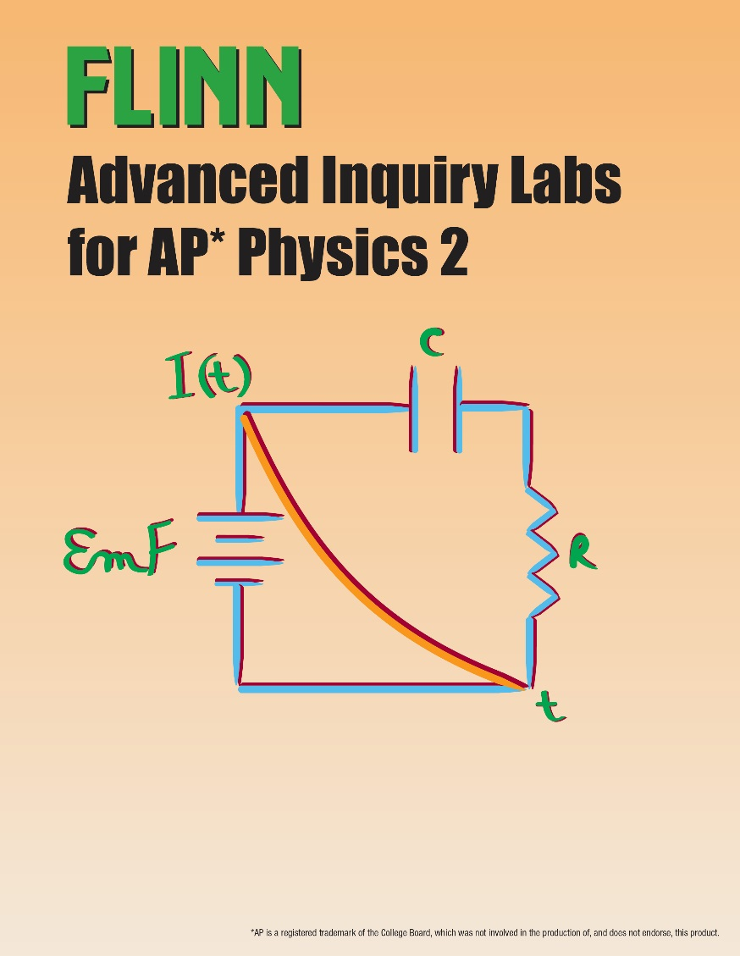
Advanced Inquiry Lab Manual
Catalog No. AP8072
Aligned with College Board Curriculum
No equipment bundle
15-Kit bundle: Catalog No.AP8012
Cost effective

Slide 36
Science Practices
• Use representations and models to communicate scientific phenomena and solve scientific problems
• Use mathematics appropriately
• Engage in scientific questioning to extend thinking or to guide investigations within the context of the AP course
• Plan and implement data collection strategies in relation to a particular scientific question
• Perform data analysis and evaluation of evidence
• Work with scientific explanations and theories
• Connect and relate knowledge across various scales, concepts, and representations in and across domains.

Slide 37
Big Ideas
Objects and systems have properties such as mass and charge. Systems may have internal structure.
Fields existing in space can be used to explain interactions.
The interactions of an object with other objects can be described by forces.
Interactions between systems can result in changes in those systems.
Changes that occur as a result of interactions are constrained by conservation laws.
Waves can transfer energy and momentum from one location to another without the permanent transfer of mass and serve as a mathematical model for the description of other phenomena.
The mathematics of probability can be used to describe the behavior of complex systems and to interpret the behavior of quantum mechanical systems

