Slide 1
How to Design a Safe and Efficient Science Laboratory

Slide 2
Step 1 Make a List
List should include things you like and dislike about your current laboratory.

Slide 3
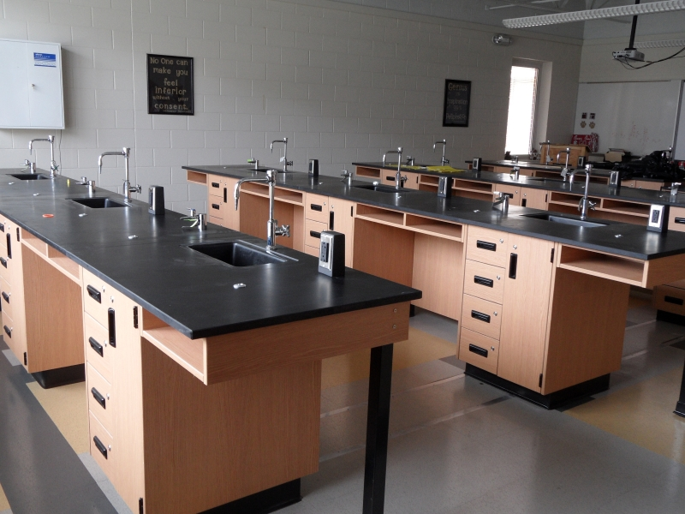
Step 2 Set the Room Parameters
Laboratory or Classroom/Laboratory?
Room Size?
Maximum Class Size?
Single Discipline or Multiple Discipline?
Will Science be the only Class Taught?
What Utilities are Needed?
What Safety Equipment is Needed?
Handicap Accessibility?

Slide 4
Step 3 List all the features you would like included in your new laboratory.
Be sure to include all those items you liked about your current lab from.
Build the list as if money was no object.
Think about how science will be taught 20-30 years from now.

Slide 5
Step 4 Visit Schools
Find out what schools have built new science facilities in your area and arrange a visit.
If possible visit schools that have worked with the architect your school is using.
Take pictures!
Talk with teachers using the new laboratories.

Slide 6
Step 5 Research Laboratory Furniture and Designs
Contact Laboratory Furniture Companies for furnishing and design ideas.
See if any or all of them will work with you to develop a layout of your room.

Slide 7
Step 6 Develop a List of Priorities
Develop lists for laboratory and storage/preparation areas.
Remember different science disciplines (chemistry, biology, physics, STEM) will have different priorities.

Slide 8
Why are Priorities Important?
Priorities keep focus on what are the important features of the laboratory.
Priorities give direction to architects, builders, and planners.
Priorities help with making the tough budget decisions.
Priorities help to prevent important items from being left off the plan.

Slide 9
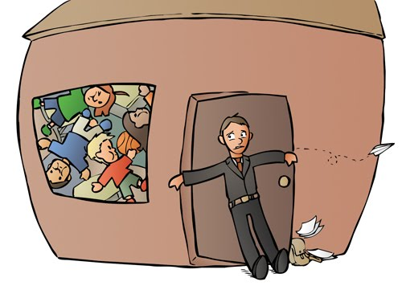
Flinn Scientific Top Two Laboratory Design Priorities
Ventilation
Space Requirements

Slide 10
Ventilation
Important for the safety of you and your students.
Overlooked in the planning phase.
Required by Federal OSHA
OSHA 1910.1450
OSHA 1910.1450 Appendix A
OSHA 1910.106 (d)(4)(iv)

Slide 11
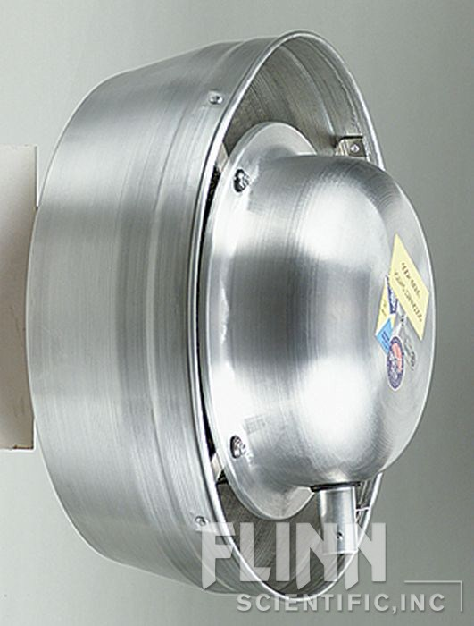
Ventilation
What you want…
In the laboratory: an on-demand system that provides a minimum of six air changes per hour (ACH).
In the storage room: 24/7/365 system that provides a minimum of six air changes per hour (ACH).

Slide 12
Space Requirements
An optimal educational science laboratory should provide:
45 sq. ft. – 50 sq. ft. per student for a dedicated laboratory room or middle school.
60 sq. ft. per student for a dedicated combination classroom/laboratory room.
Clear routes of travel.
Good sight line for supervision.

Slide 13
Layouts to Avoid

Slide 14
Divided Classroom/Laboratory

Slide 15
Blended Classroom/Laboratory

Slide 16
Laboratory Only: Perimeter Pier

Slide 17
Laboratory Only: Forward View

Slide 18
Middle School/Physics Classroom Layout

Slide 19
Middle School/Physics Laboratory Layout

Slide 20
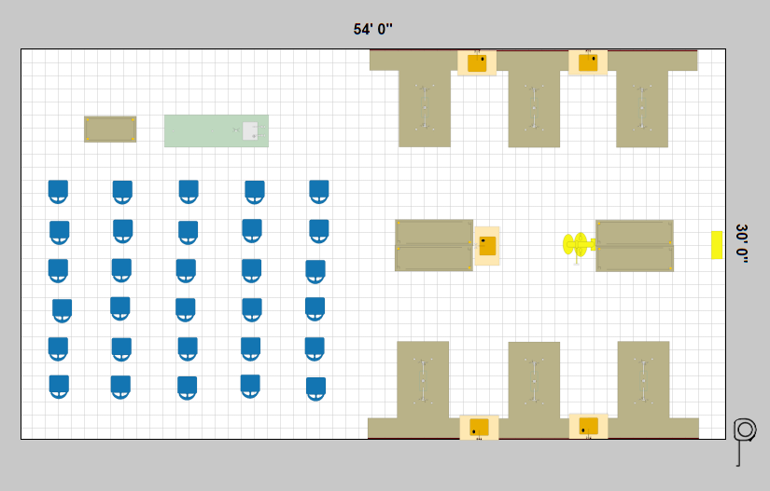
Where to Start? Take Control!
www.flinnsci.com/udesign
With UDesign™ you can:
Compare a variety of lab designs and options.
Participate in creating a customized learning environment.
Communicate your ideas to administrators and architects.

